Slide 1
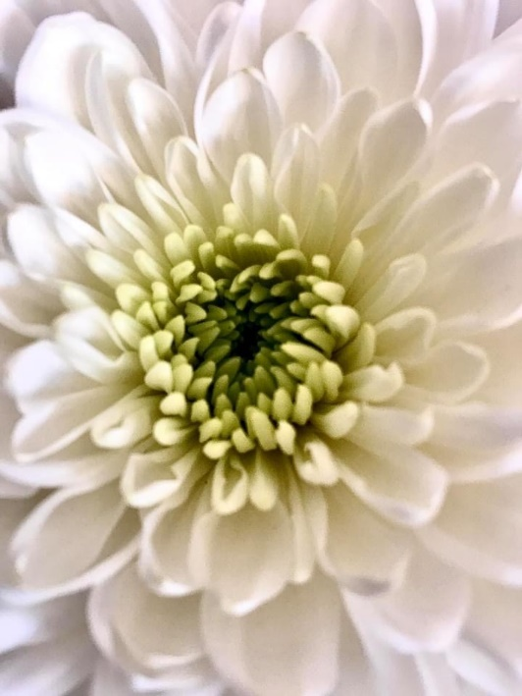
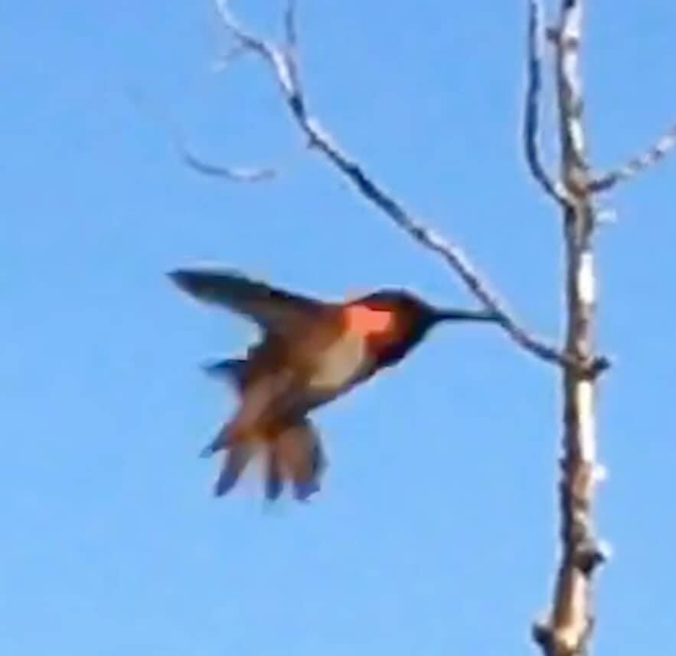
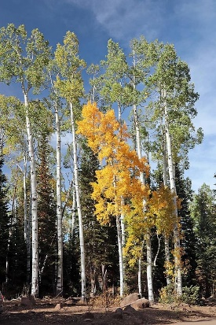
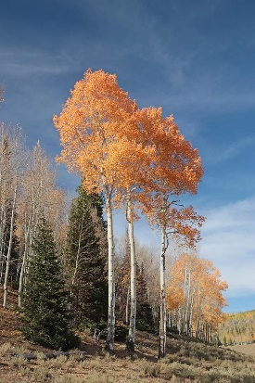
Science Camp #2022.14 Theme: Water
10-12 June 2023 @
Nelson Cabin and Surrounding Area
Advisors:
H. Roice Nelson, Jr., Andrea S. Nelson,
Paul & Kate Nelson, Melanie Wright, Sara Ellen & Bobby Beckmann. Audrey Waldron & J.D. Nielson
Attendees:
Grant Matthew Nelson, Dallin Spencer Nelson, Avalyn Ashby Wright,
Quinton Miles Nelson, Kendall Joyce Wright, Bobbie Sophia Waldron, Isabella Malani Waldron, Lauren Rachel Waldron, Chloe Grace Nelson
Guest: Sage Beckmann

Slide 2
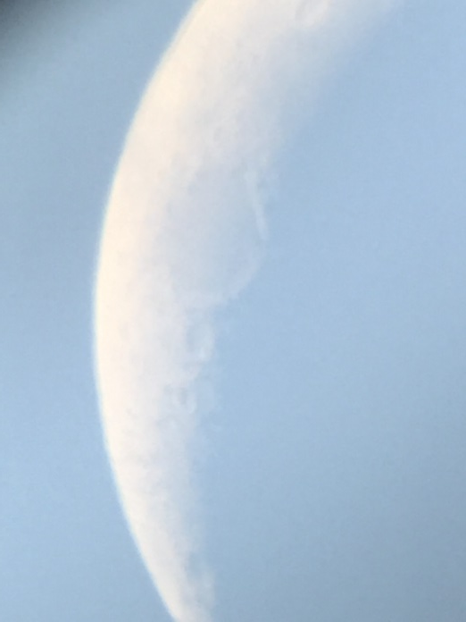
Past Science Camp Themes & Sites Visited
Nelson Cabin, Fishing, Condensation, Water Coloring, and Music
Nelson Cabin
Panquich Lake
Swimming at Cedar City Aquatics Center
Mining Range, Frisco, Silver Reef, Iron Town, Astronomy at Frisco Peak, Archery
Nelson Cabin, Kolob Reservoir, Silver Reef, Snow Canyon, Volcano
Parowan Gap, Rack Range Mines, Frisco, Frisco UU Telescope
Iron Mine, Iron Town
Geocaching, Mammoth Cave, Cascade Falls, and Cedar City Cemetery
Nelson Farm, Fiddler’s Canyon,
Boys to Mammoth Cave, Cascade Falls and Girls to St. George and Pottery Making
Cedar City Cemetery
Volcanoes, Classy Closets, Maps, Surveying, Sand Painting, and Genealogy
Condo, Snow Canyon Volcanoes, Classy Closets, Fiddler’s Canyon
Nelson Farm to survey, Nelson Cabin
Cedar City 24th of July Parade
Patterns, Horse Riding, Internet, Be-a-man-campout
Dust Devil Ranch, InfoWest, Fiddler’s Canyon
Nelson Cabin
Cedar City July 4th Parade
Music & Spoken Word, SilencerCo, Indian Tribes & Archaeology, Solar Astronomy
Family Discovery Center, Sophie & Dallin’s Baptism, SilencerCo, Music & Spoken Word, UU Science Museum
Freemont Indian Museum, Boulder Anasazi Ruins, Escalante Petrified Forest, Bryce Canyon
Parowan Gap, Solar Astronomy, Nelson Cabin, Uncle Des’ & Aunt Sara’s, Swimming
Rock Cutting, SUU Museum, Computer Hardware and Software, Cabin
1st Annual Fun Run / Walk, rock collection Bloody Ridge, rock cutting and polishing
HTML at SUU, and Lego Robots at Nelson Cabin
Astronomy at Nelson Cabin, Bottle Rockets, and having a good time
8G: Geography, Genetics, Genealogy, Grandma, Grandpa, Geology, Geophysics, & Guitar
Watered garden, 2nd Annual Fun Run / Walk, Iron Springs, Iron Town, Genetics, Cabin, Guitar
Zion, Angels Landing & Emerald Pools, Geophysical Slides
Bottle Rockets, swimming, and having a good time
Garden of the Gods, Drones, Intercontinental Divide, Teepee, Salida Hot Springs, University Mountains
Bow & Arrows, Drone, Intercontinental Divide
Guitar and Buena Vista 4th of July Parade
Mount Antero, Hot Springs at Salida, Teepee
Eisenhower Park, Guadalupe River, i-Fly, Cave Without a Name, Alamo, San Antonio
Hike to overlook San Antonio, i-Fly, swimming Guadalupe River State Park
Cave without a Name, Singing, Rob Nelson on Sound and Music
Alamo, Wax Museum, San Antonio Riverwalk
Engines, Ghost Towns and Kilns, Nelson Cabin, Al Matheson’s Place, Iron Springs Resort
Fisco, Kiln Springs, Nelson Cabin
Teepees at Nelson Cabin, water races, Dutch Oven
Matheson Engines, 4-wheelers, Iron Springs statues, Bottle Rockets, Ride in a Tesla
12. Warner Cabin, Gravity, Zip Lines, & Experiments
Warmer Cabin and Panquich Lake
Marysville Zip Line & Lazy River
Bryce Canyon and Gravity Experiments
13. Nelson Cabin, Light, Distance, Physics, Lasers
Green Show & All’s Well That Ends Well
James Webb Telescope, Stargazing
Cascade Falls, Water Rockets

Slide 3
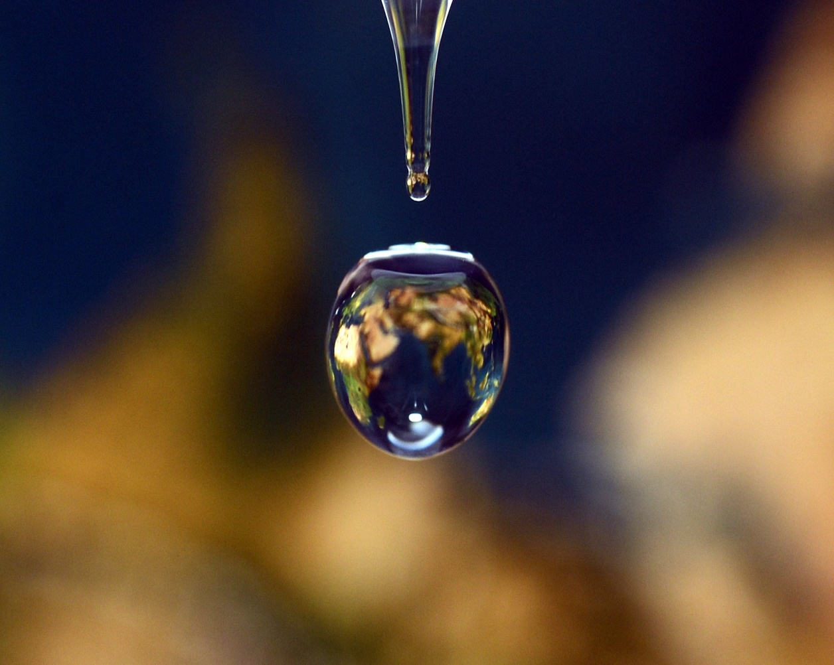
14th Annual Nelson Grandkids’ Summer Science Camp; Theme: Water
Photos + slides to be posted at:
http://www.walden3d.com/photos/Grandkids_Science_Camps/220710-12_Science_Camp
Itinerary
Saturday:
J.,D. Audrey, Sophie, Izzy, & Lauren arrive Las Vegas, 12:30, and go to St. George and Zion.
Sunday:
Melanie, Avalyn, & Kendall arrive Provo, 1:22, to Grandpa’s & Grandma’s.
Bobby, Sara, Sage, & Rob arrive Las Vegas, 4:00, to Aunt Sara’s.
Paul, Kate, Grant, Dallin, Quinton, & Chloe arrive.
7:00 Grandpa’s talk on Sons of Utah Pioneers.
Monday:
9:00 Breakfast at the Garden.
11:00 Science of Water at Iron Springs Adventure Resort.
2:00 Lunch at Aunt Sara’s.
4:00 Pick up Kayaks, Put up Tree Tent, Play at Cabin.
6:00 Hot Dogs & watermelons & smores for Dinner.
8:00 Christmas in July.
Tuesday:
8:00 Pancake breakfast at the Cabin.
10:00 Fishing and Swimming at Kolob Reservoir.
1:00 Lunch at Kolob Reservoir.
3:00 Drive to Virgin – take Kayaks back.
7:00 Dinner at Cabin.
8:00 Audrey’s Finances & Quinton & Chole Science Kit.
Wednesday:
8:00 Bagel breakfast and Play at the Cabin.
9:00 Water Games and Water Rockets.
12:00 Lunch at the Cabin.
2:00 Take down tent and Clean Cabin.
3:00 Swimming at Natatorium & Lake on the Hill.
5:00 Pizza at Grandma and Grandpa’s
6:00 Green Show and most to Romeo & Juliet.
7:00 Melanie & Paul’s Families to Provo.
Thursday:
8:00 Breakfast at house.
10:00 Sara, Bobby, Sage, & Rob to Las Vegas
Good Times!

Slide 4
Schedule Saturday-Thursday
Saturday, 08 June 2023
J.D., Audrey, Sophie, Izzy, & Lauren arrive Las Vegas, 12:30, to St. George and Zion.
Sunday, 08 June 2023
Melanie, Avalyn, & Kendall arrive Provo, 1:22, to Grandma’s.
Bobby, Sara, Sage, & Rob arrive Las Vegas, 4:00, to Aunt Sara’s.
Paul, Kate, Grant, Dallin, Quinton, & Chloe arrive.
7:00 Grandpa’s talk on Sons of Utah Pioneers at Fiddler’s Chapel.
Monday, 09 June 2023
9:00 Breakfast at the Garden.
11:00 Science of Water at Iron Springs Adventure Resort.
2:00 Lunch at Aunt Sara’s.
4:00 Pick up Kayaks, Put up Tree Tent, Play at Cabin.
6:00 Hot Dogs & watermelon & smores for Dinner.
8:00 Christmas in July.
Tuesday, 20 June 2023
8:00 Pancake breakfast at the Cabin.
10:00 Fishing and Swimming at Kolob Reservoir.
1:00 Lunch at Kolob Reservoir.
3:00 Drive to Virgin – take Kayaks back.
7:00 Dinner hamburgers, cobbler, root beer, Dutch Oven at Cabin.
8:00 Audrey’s Finances & Quinton & Chloe’s Science Kits.
Wednesday, 29 June 2022:
8:00 Bagel breakfast and Play at the Cabin.
9:00 Water Games and Water Rockets.
12:00 Left over lunch at the Cabin.
2:00 Take down tent and Clean Cabin.
3:00 Swimming at Natatorium & Lake on the Hill.
6:00 Green Show and most to Romeo & Juliet.
7:00 Melanie & Paul’s Families to Provo.
Thursday, 30 June 2022:
8:00 Breakfast at house.
10:00 Sara, Bobby, Sage, & Rob to Las Vegas
10:00 Audrey, Sophie, Izzy, & Lauren shopping St. George.
Friday, 01 July 2022:
10:00 Audrey, Sophie, Izzy, & Lauren shopping St. George.
12:00 Grandpa & Grandma Clean Cabin.
Saturday, 02 July 2022:
10:00 Audrey, Sophie, Izzy, & Lauren to Vegas for flight.
12:00 Grandpa & Grandma Dutch Oven Dinner for friends at Cabin.

Slide 5
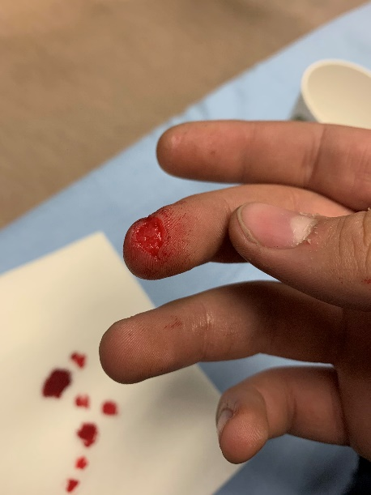
Safety
Never go anyplace alone, preferably 3+.
Exception is if one of you is hurt, then:
One of you stay and help the person hurt.
The other one run and get help.
If you get lost stay put, we will find you.
If you hear a rattlesnake do not move quickly, just slowly move away from the sound.
Do not run with a knife open. Use knife safety.
If you cut yourself, apply pressure to the wound to stop bleeding, and send for help.
Never point an arrow in a cocked bow or a gun at any person.
Drink lots and lots and lots of water.
Do not go swimming unless an adult is with you.
Do not start branches on fire and swing them around where others can be hurt.
Have fun, use common sense, and think before you act.

Slide 6
Job Chart
Everybody picks up their own dishes!
Everyone cheerfully does what asked to do by Grandpa, Grandma, Uncle Paul, Aunt Kate, Aunt Melanie, Aunt Sara, Aunt Audrey, or other adults.
Monday | Tuesday | Wednesday | Thursday
Breakfast: Edwin Gurr Everyone Help Cleanup | Breakfast: Melanie & Audrey Izzy & Kendall | Breakfast: Sara & Bobby Grant | Breakfast: Grandma & Grandpa Everyone Help Cleanup
Lunch: Aunt Sara Everyone Help Cleanup | Lunch: Paul & Kate Dallin & Chloe | Lunch: Rob Everyone Help Cleanup
Dinner: Grandma Sophie & Avalyn | Dinner: Grandpa Lauren & Quinton | Dinner: Pizza Everyone Help Cleanup

Slide 7
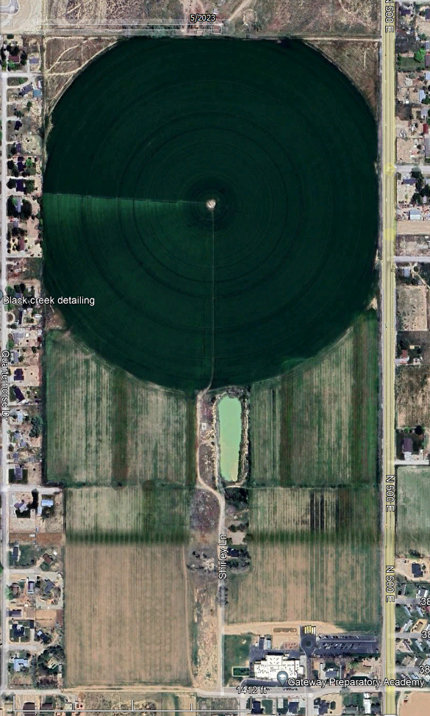
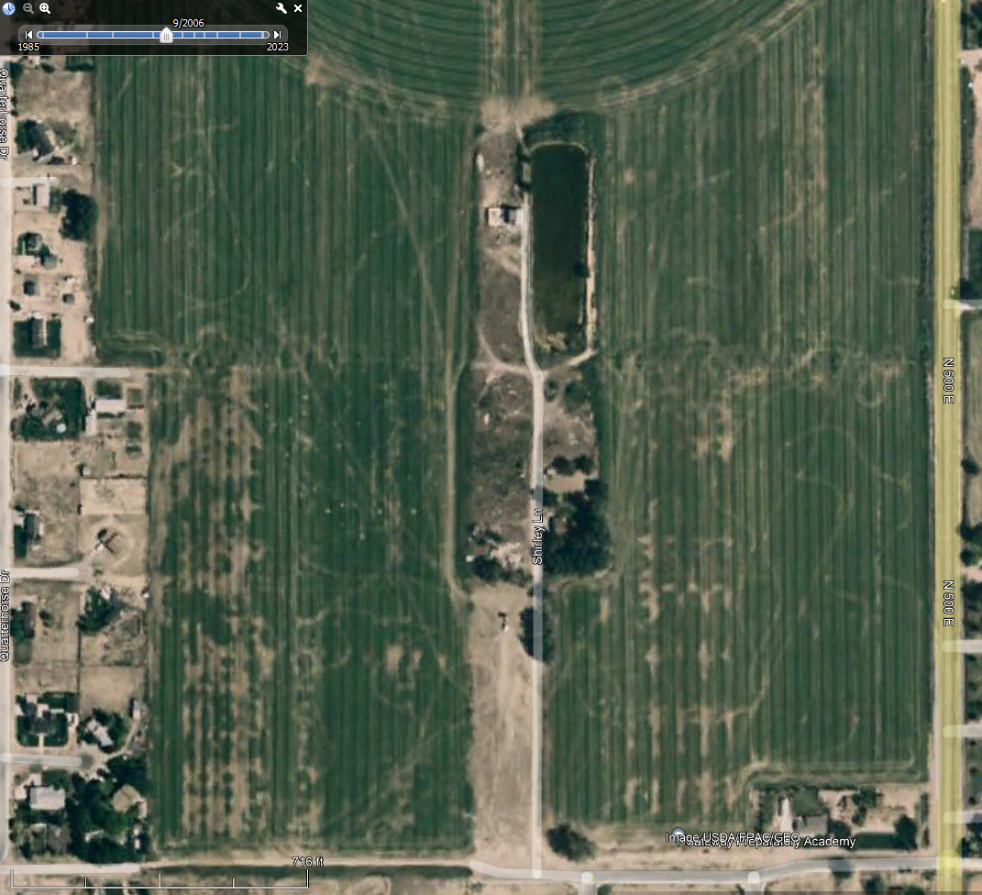
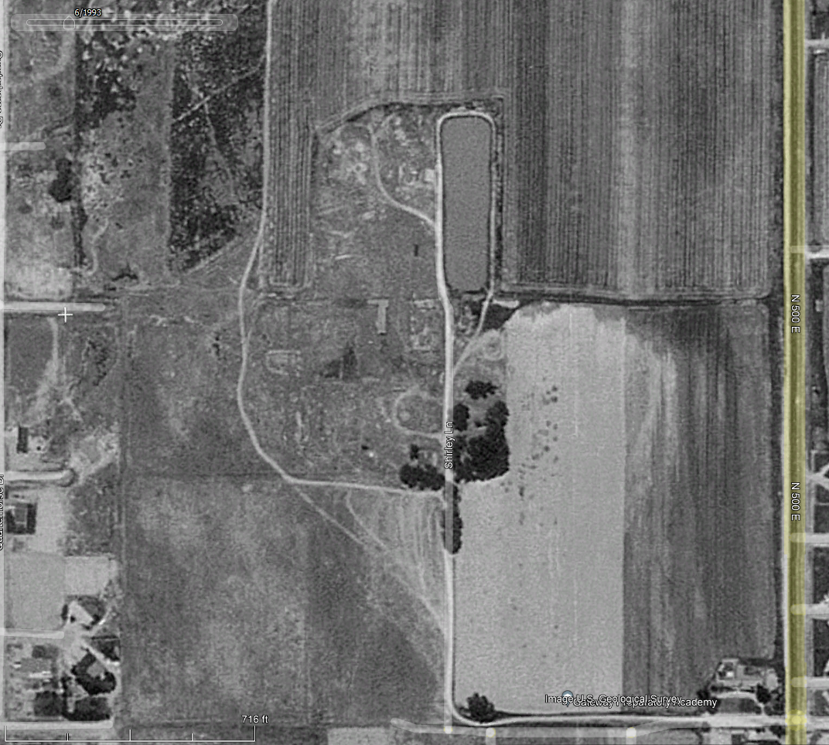
Nelson Farm
May 2023
September 2006
Stink Plant
Pond
Barn
Corrals
Meat Plant
Grandmas
Gateway
Childhood
Home
June 1993

Slide 8
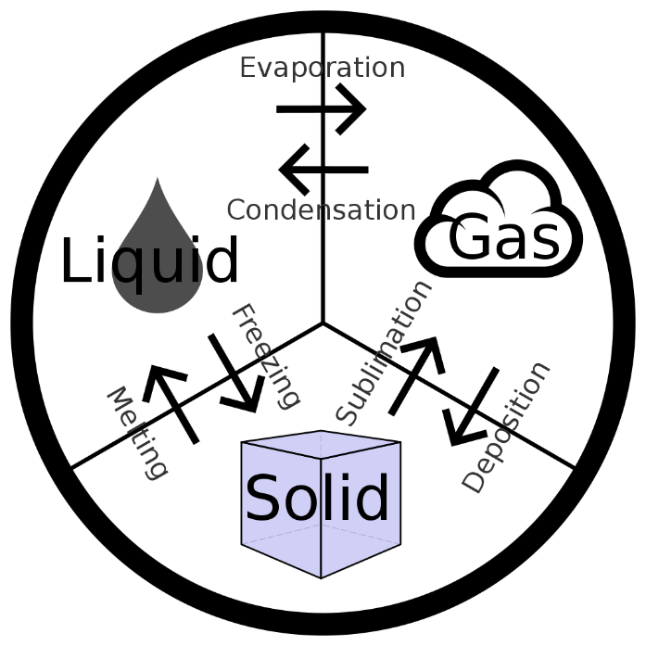
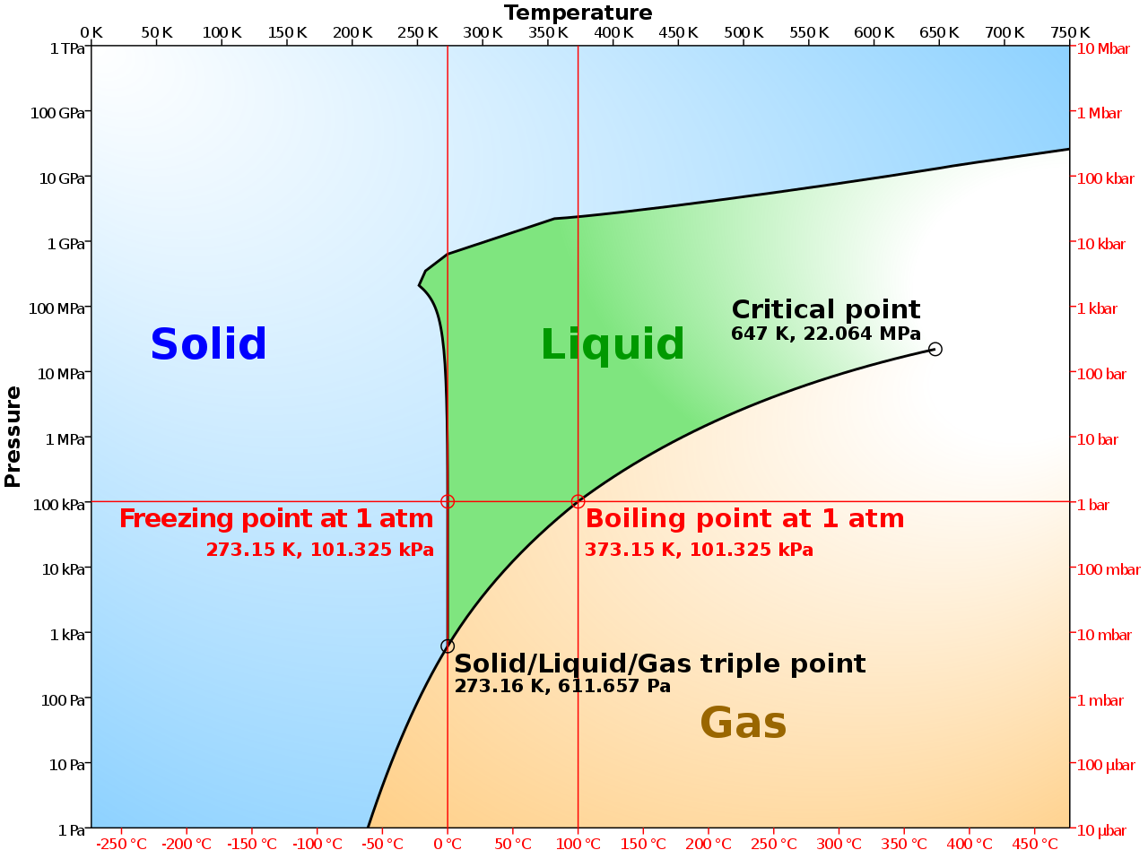
Water Science
Basic Questions:
Who?
What?
Why?
Where?
When?
Four Components of water chemistry affecting water quality:
Temperature;
Acidity (pH);
Dissolved Oxygen; &
Electrical Conductance (minerals in the water).

Slide 9
Water at the Triple Point
Movie of water at Triple Point in a vacuum, UCSC Physics
https://www.youtube.com/watch?v=Juz9pVVsmQQ&ab_channel=UCSCPhysics

Slide 10
Why does Water Expand When it Freezes

Slide 11
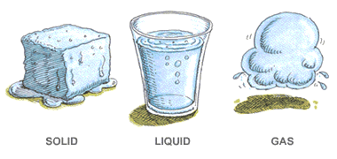
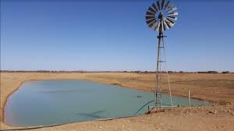
1. Who Uses Water?
Families Use Household Water:
Drinking
Cooking
Washing
Farmers Use Irrigation Water:
Households
Livestock
Agriculture
Cities Use Groundwater:
Fresh Water
Saline Water
Geothermal Water
Governments Use Seawater and Tides:
An average of 3.5% sodium chloride plus smaller amounts of other substances;
Tides are cyclic rising and falling of local sea levels caused by lunar and solar gravity;
Bathymetry is the depth to the bottom of a lake, or to the sea floor.

Slide 12
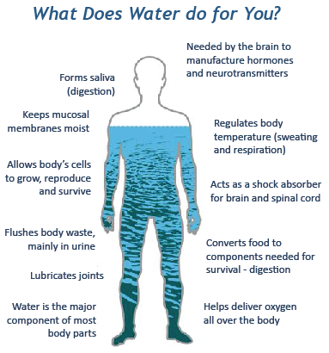
Water is Life
All the biochemical processes which occur in plants and animals, and our surroundings require water to function:
Up to 60% of the human adult body is water.
The brain and heart are composed of 73% water.
The lungs are about 83% water.
The skin contains 64% water.
Muscles and kidneys are 79% water.
Even the bones are watery: 31%.
Water serves a number of essential functions to keep us all going:
A vital nutrient to the life of every cell, acts first as a building material;
It regulates our internal body temperature by sweating and respiration;
The carbohydrates and proteins that our bodies use as food are metabolized and transported by water in the bloodstream;
It assists in flushing waste mainly through urination
acts as a shock absorber for brain, spinal cord, and fetus;
forms saliva; and lubricates joints
https://www.usgs.gov/media/images/water-you-what-water-does-your-body

Slide 13
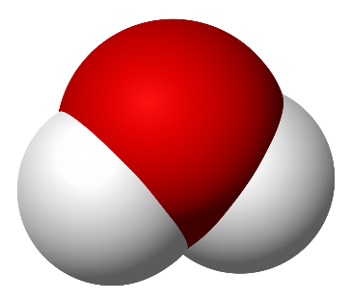
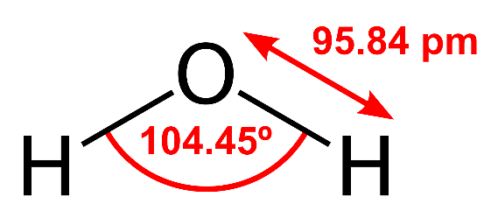
2. What Is Water?
Water is:
An inorganic compound with the chemical formula H₂O;
Each molecule contains one oxygen and two hydrogen atoms;
The atoms are connected by covalent bonds (sharing electrons to form electron pairs between atoms);
A transparent, tasteless, odorless, and nearly colorless substance;
The main constituent of the Earth’s hydrosphere;
The fluids of all known living organisms;
A solvent vital for all known forms of life; and
The liquid state of H₂O at standard temperature and pressure.

Slide 14
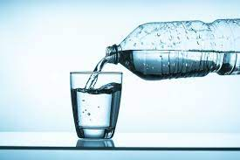
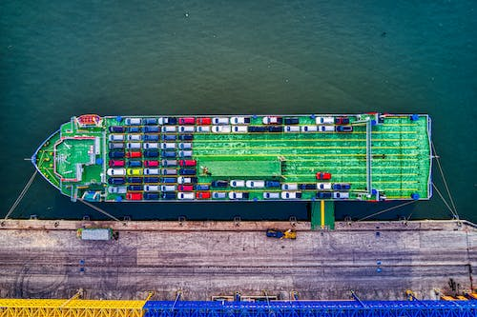
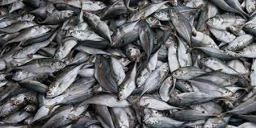
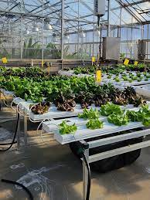
3. Why Is Water Important?
Because Earth’s environment is relatively close to water’s triple point:
Water exists on Earth as a solid (ice), a liquid (water), & a gas (water vapor);
It forms precipitation in the form of rain and aerosols in the form of fog;
Clouds consist of suspended droplets of water and ice;
Ice is water’s solid state (dry ice is carbon-dioxide (CO₂)’s solid state);
Crystalline ice may precipitate in the form of snow;
The gaseous state of water is steam or water vapor;
Water covers 71% of the Earth’s surface (seas and oceans 96.5% of this volume);
1.7% of Earth’s water is groundwater;
1.7% of Earth’s water is in glaciers and ice caps of Antarctica & Greenland;
0.001% of Earth’s water is in the air as vapor, clouds, & precipitation.
70% of freshwater used by humans is for agriculture;
Fishing in salt & fresh water is a major source of food, providing 6.5% of global protein;
Much of long distant trade is transported by boats through seas, rivers, lakes, & canals;
Water, ice & steam are used for cooling, heating, solvents, cooking, & washing in industry & homes;
Basis of swimming, boating, racing, surfing, fishing, diving, ice skating, skiing, & snow boarding.

Slide 15
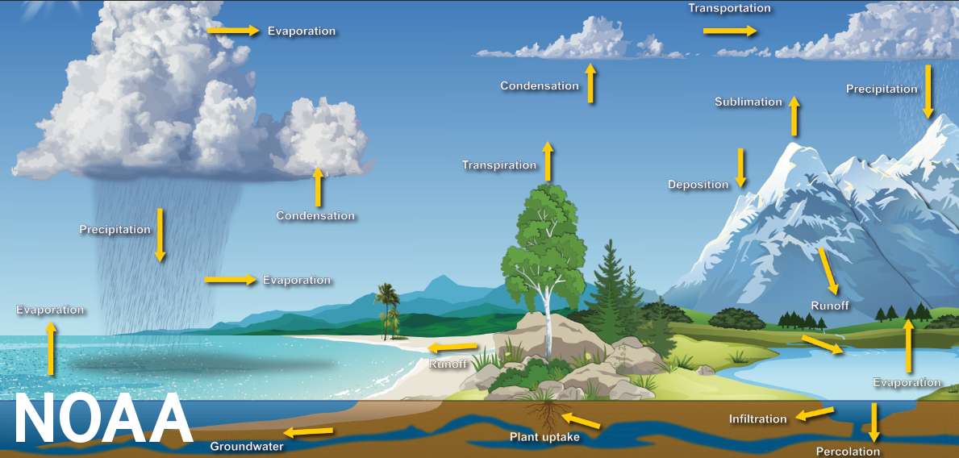
The Water Cycle
m
(Image credit: Dennis Cain/NWS) https://www.noaa.gov/education/resource-collections/freshwater/water-cycle

Slide 16
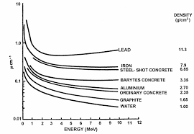
Other Reasons Water is Important:
Water covers nearly 3/4 of the Earth's surface or:
326,000,000,000,000,000,000 gallons or
326 quintillion gallons
About 6,800 gallons of water are required to grow a day’s worth of food for a family of four.
Water has the greatest thermal conductivity except for mercury
Water can act as either an acid or a base but is neutral
Gamma-ray attenuation coefficients
https://inis.iaea.org/collection/NCLCollectionStore/_Public/40/007/40007648.pdf

Slide 17
Water Cohesion

Slide 18
Water Adhesion

Slide 19
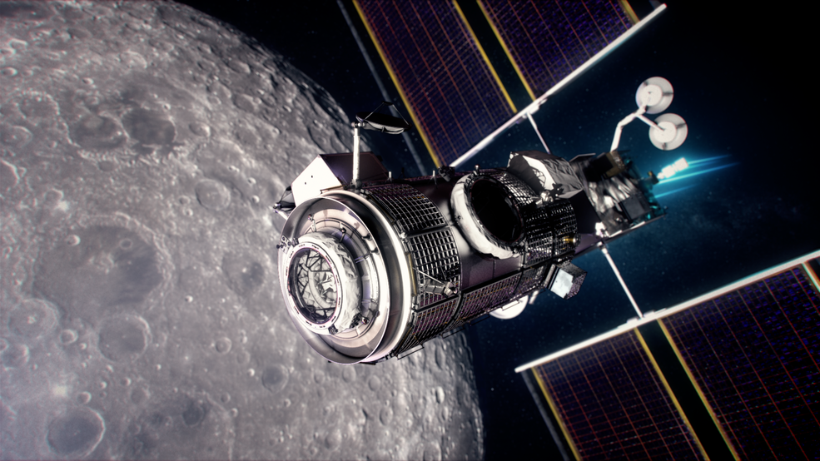
Radiation Shielding with Water
Uncle Paul’s Company, Northrop Grumman, is using this principle to line the walls of the HALO (Human Adaptability Logistics Outpost); building with water for astronauts while they orbit the moon: https://www.nasa.gov/press-release/nasa-northrop-grumman-finalize-moon-outpost-living-quarters-contract

Slide 20
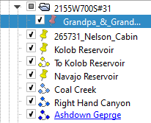
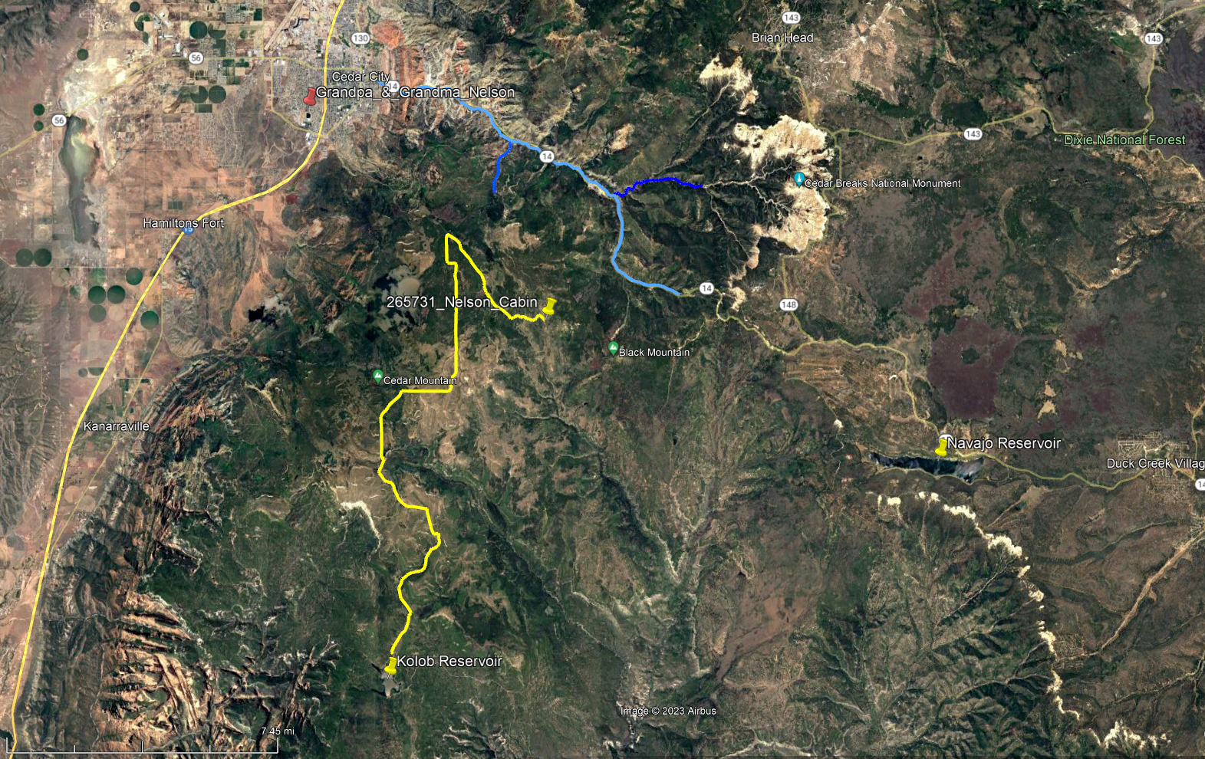
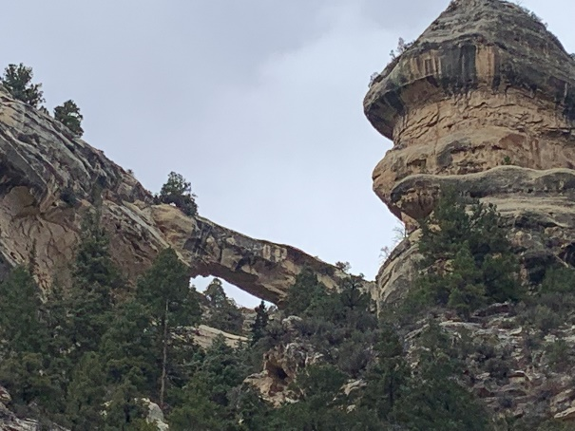
4. Where Is Water Found?
Flannagan’s Arch

Slide 21
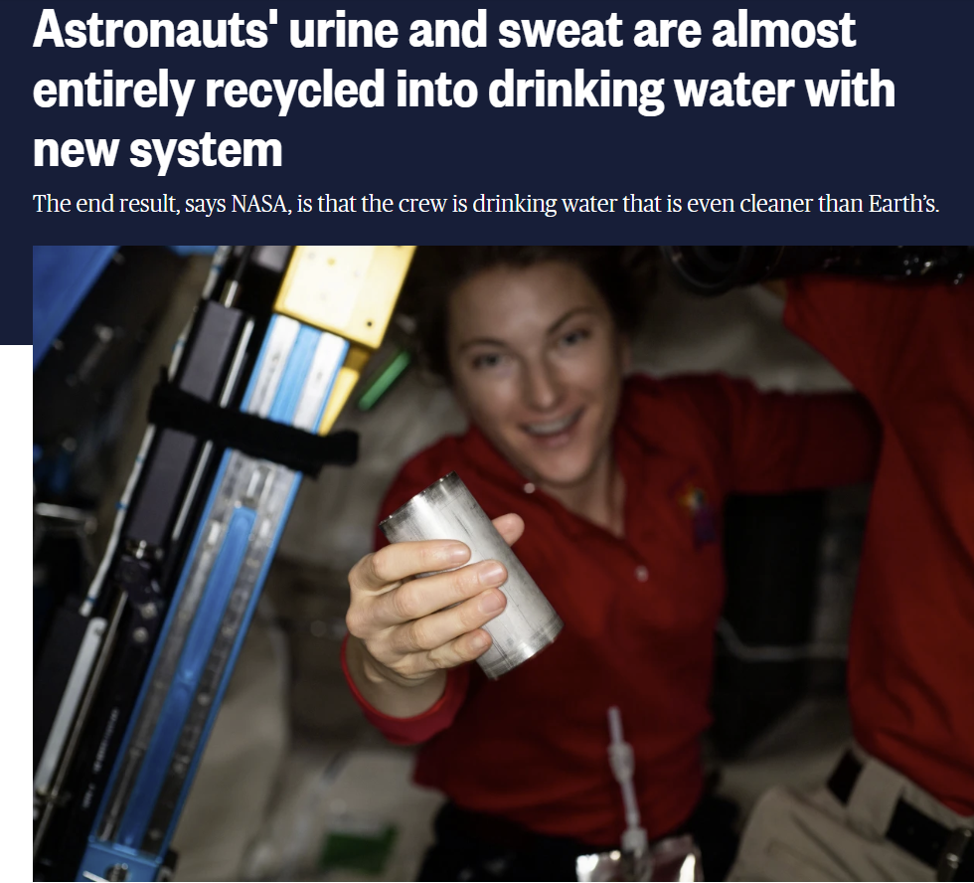
Drink your own pee and sweat

Slide 22
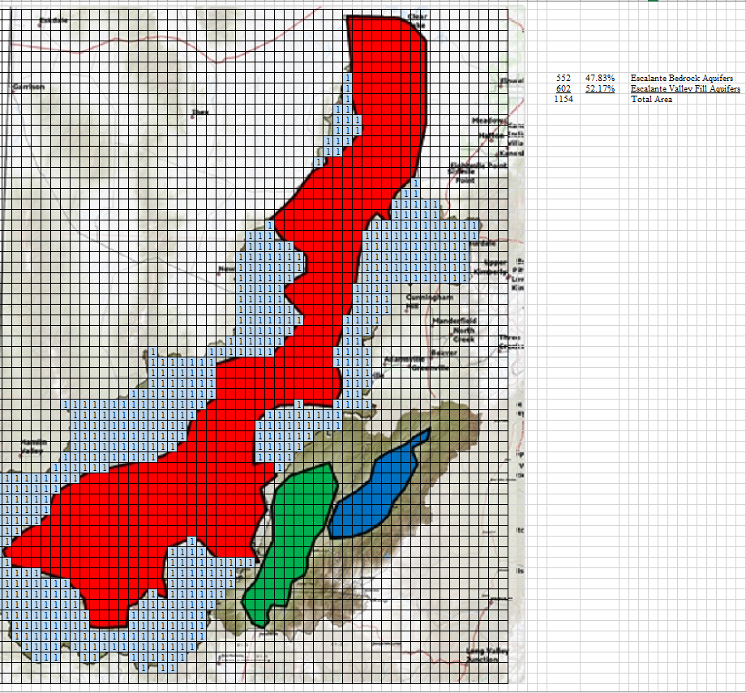
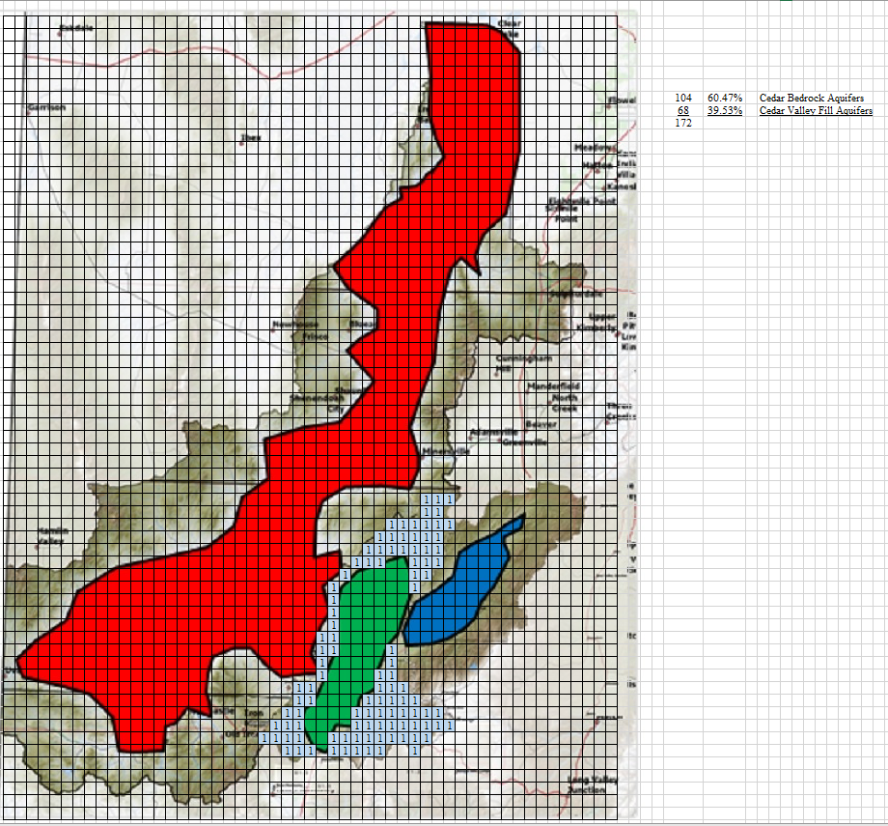
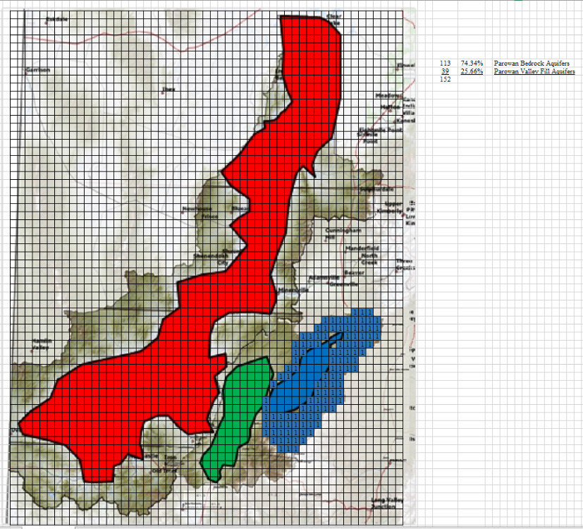
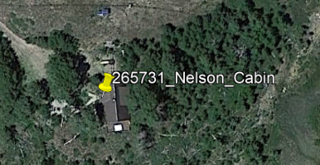
Where Is Water Found in the Utah Deserts?
Escalante Valley:
blue – bedrock aquifers
red – valley fill aquifer
Cedar Valley:
blue – bedrock aquifers
green – valley fill aquifer
Parowan Valley:
blue – bedrock aquifers
blue – valley fill aquifer

Slide 23
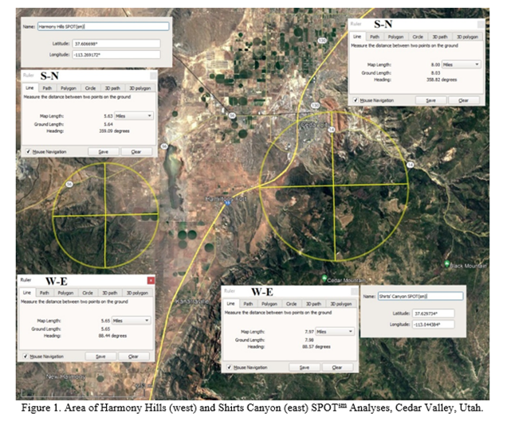
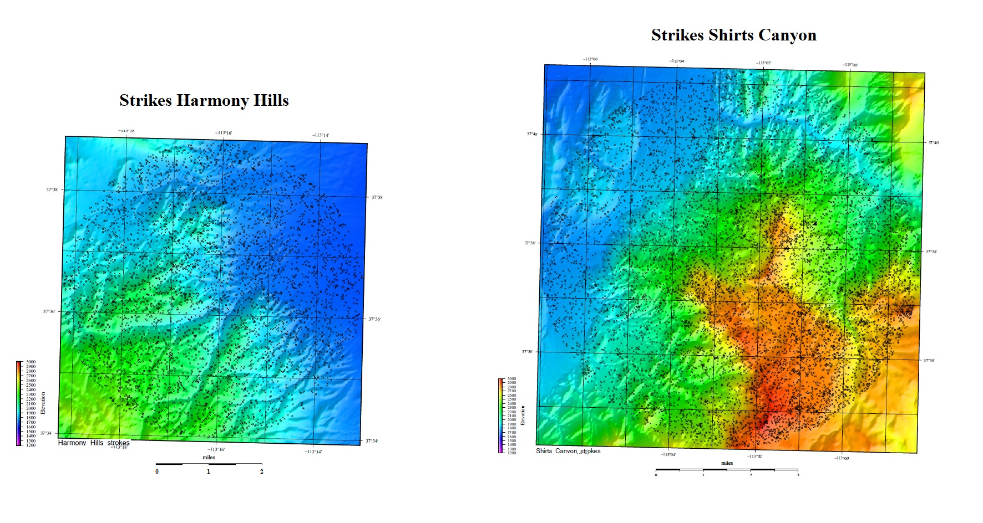
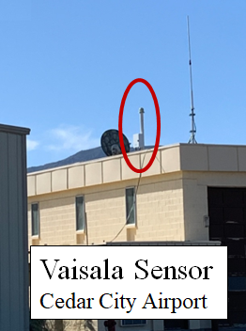
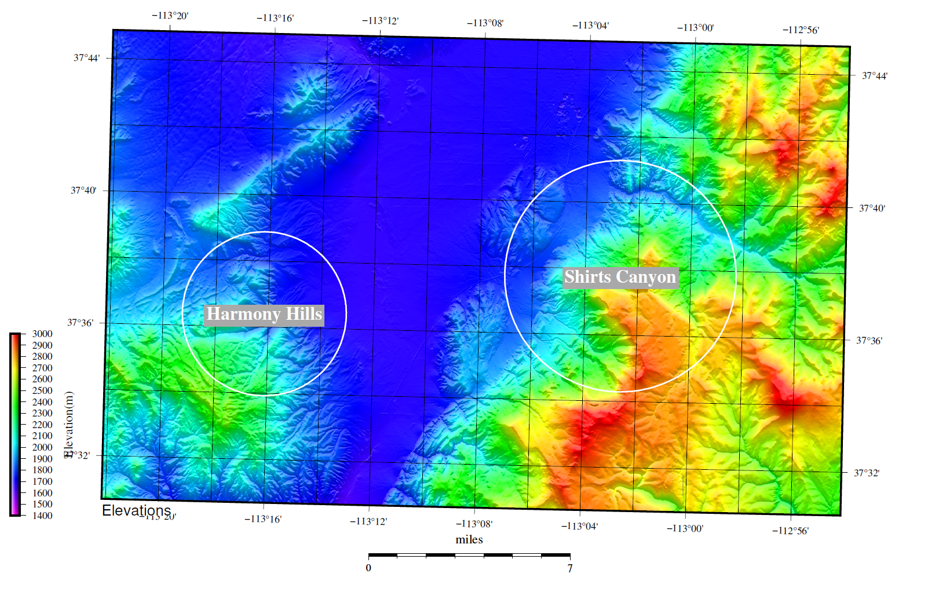
Cedar Valley Lightning Analysis
Dynamic Measurement as a subcontractor
to Willowstick Technologies:
Did 2 Lightning SPOT^{sm} Analysis in March 2022.
Unraveling the thrust faulting in Shirts’ Canyon.
Identifying likely bedrock aquifers.
One well found muddy water where predicted.
The other well found artesian water and is currently being deepened another 600 feet.
There are many other potential well locations.

Slide 24
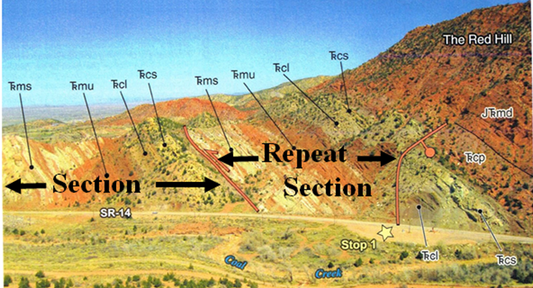
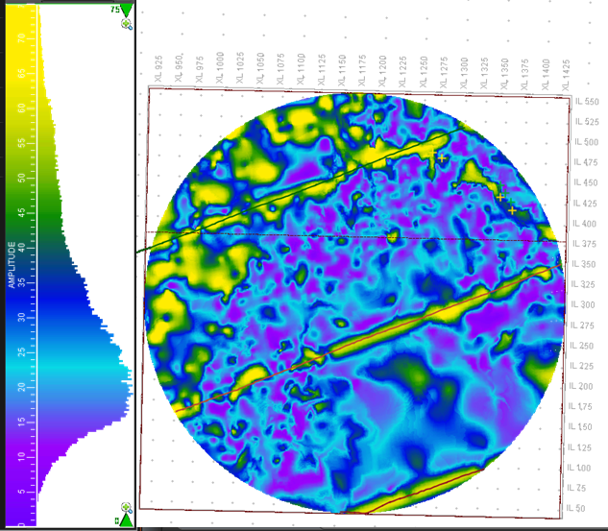
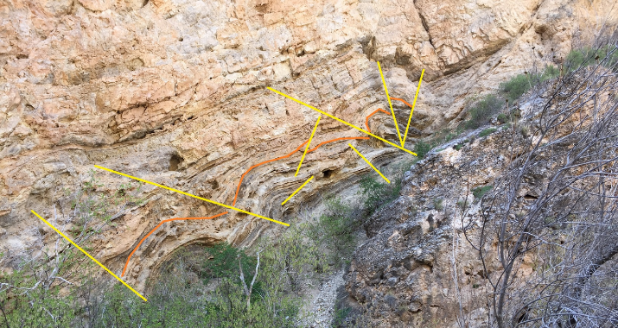
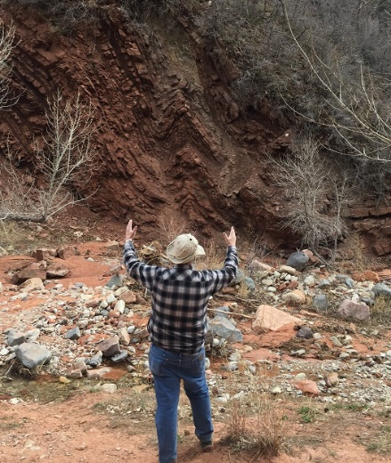
Thrust Faulting Shirt’s Canyon
Symmetry Lightning Attribute
1,500- meter Depth Slice
Cedar Canyon Back Thrust
Spring Creek Canyon Thrust
Taylor Creek Canyon Thrust

Slide 25
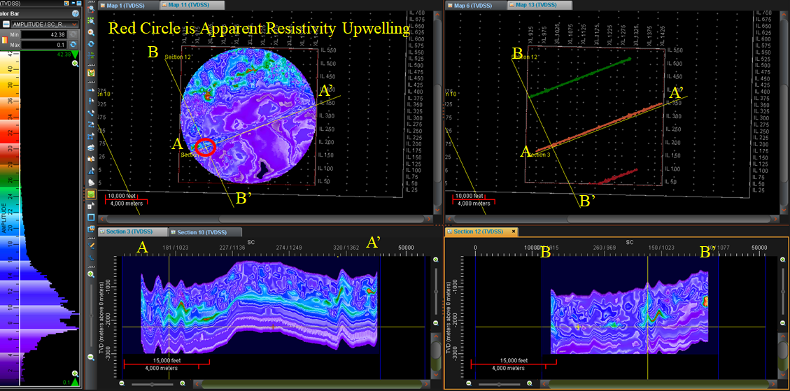
Shirts Canyon Shallow Resistivity L177 T1010

Slide 26
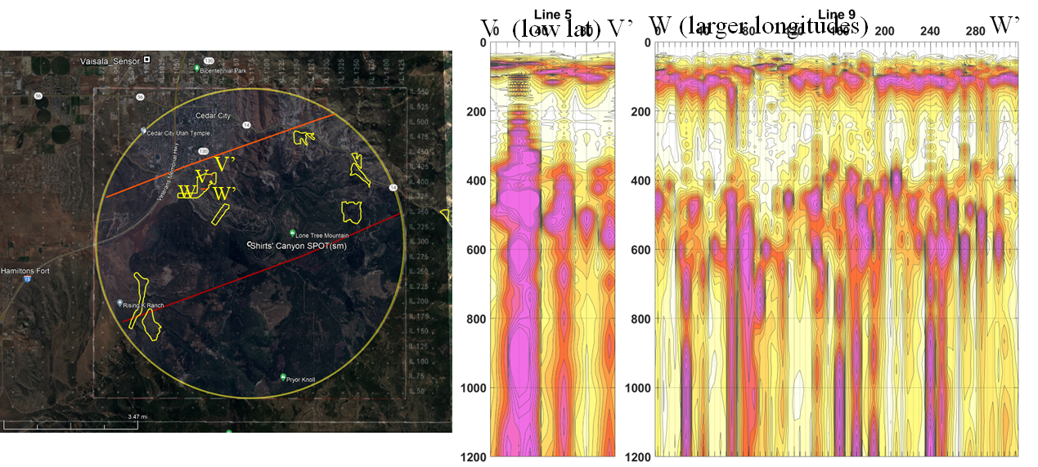
Willowstick Measurements Southview: 5-GH G2 RAP Lines 5 & 9

Slide 27
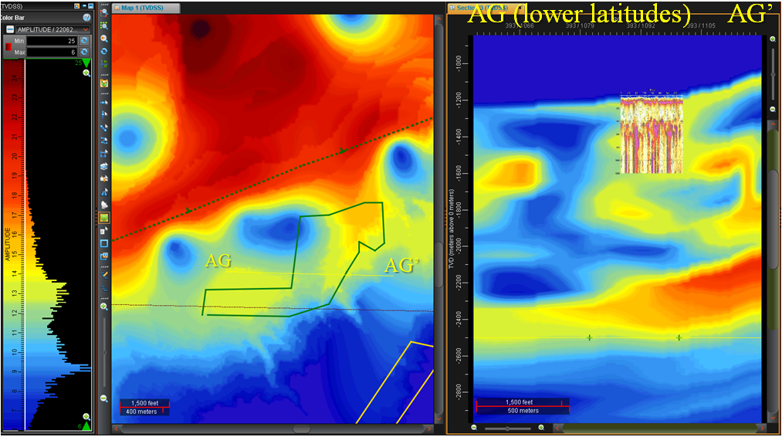
Southview: 5-GH G2 RAP Lines 5 & 9, Line 9 , ~overlay of W-W’ previous slide

Slide 28
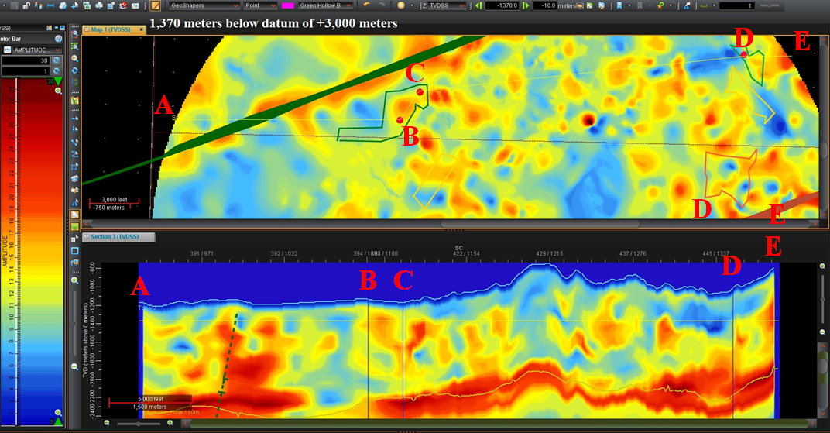
Zoom Resistivity Slice -1,370 meters Green Hollow Area

Slide 29
5. When Is Water Important?
When you are thirsty.
When you are hot.
When your eyes, mouth, and nose are dry.
When you are dehydrated.
When your joints ache.
When your spinal cord and back hurt.
When nutrients need to be moved to cells.
When there are digestion issues.
When you need to pass a kidney stone.
When you need to get rid of wastes to lesson the burden on kidneys by urination, perspiration, and bowel movements.
When you need it to wash vegetables or dishes.
When you need to flush a toilet.
When you need to run an air conditioner.
Whenever you need water for work or play or life.

Slide 30
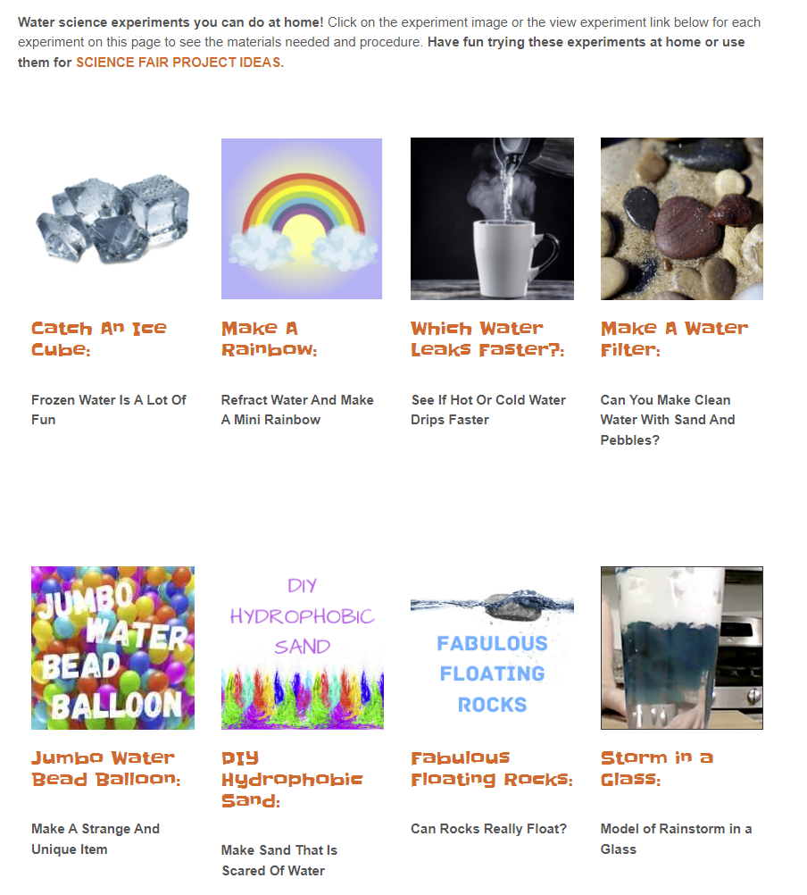
Water Science Experiments you can do at Home
https://www.sciencefun.org/kidszone/experiments/water-science-experiments/

Slide 31
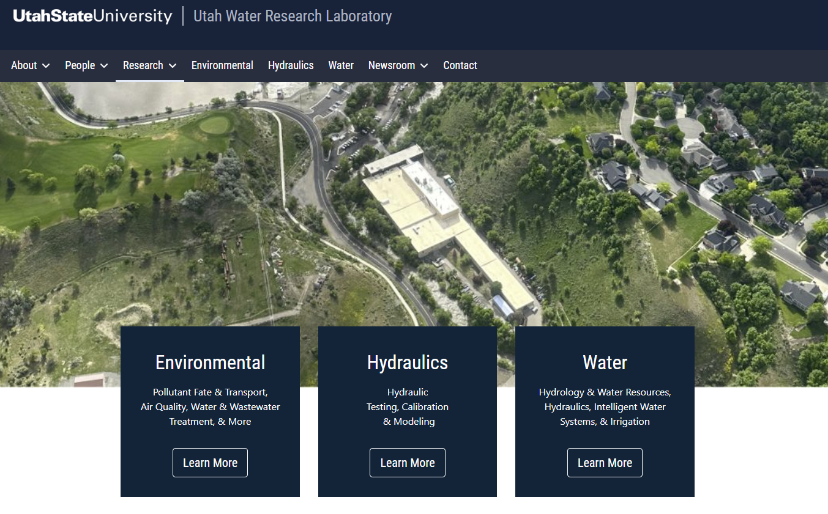
Water Research Opportunities
https://uwrl.usu.edu/

Slide 32
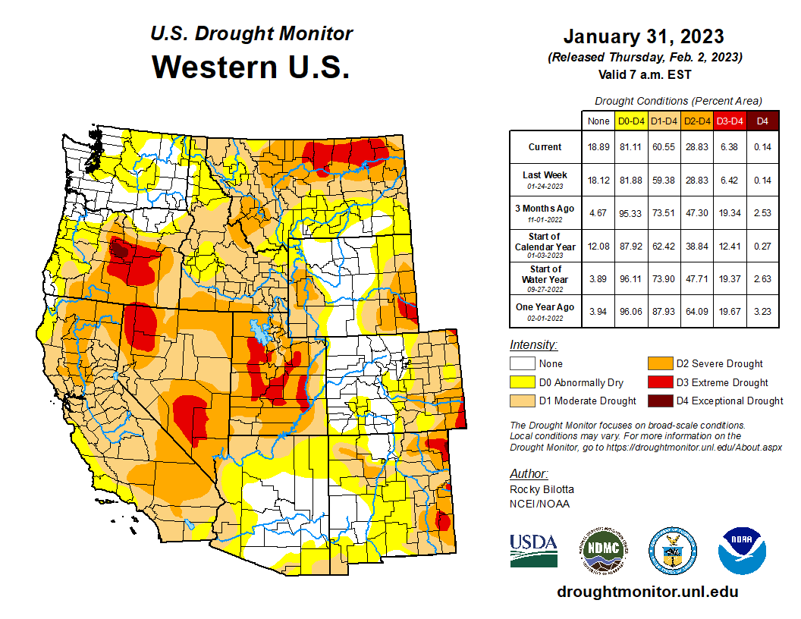
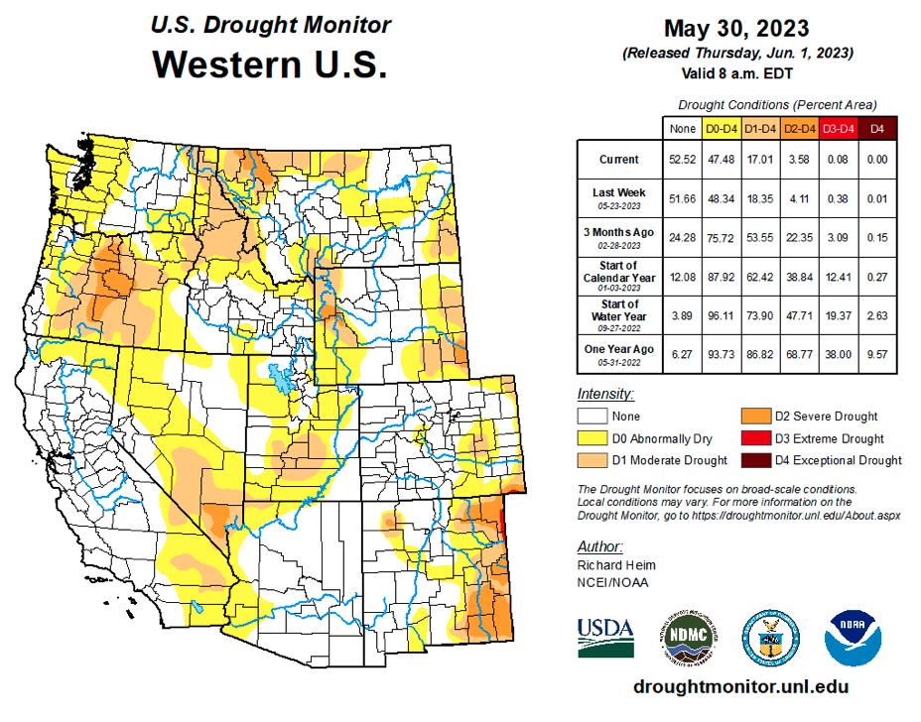
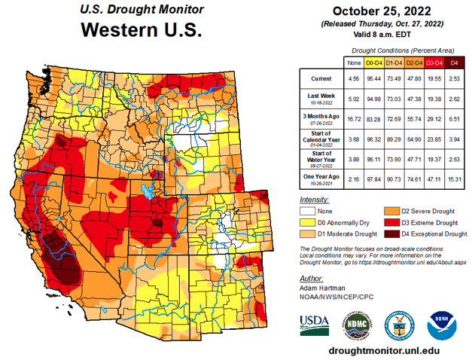
Great Salt Lake is Drying Up and We will all die!

Slide 33
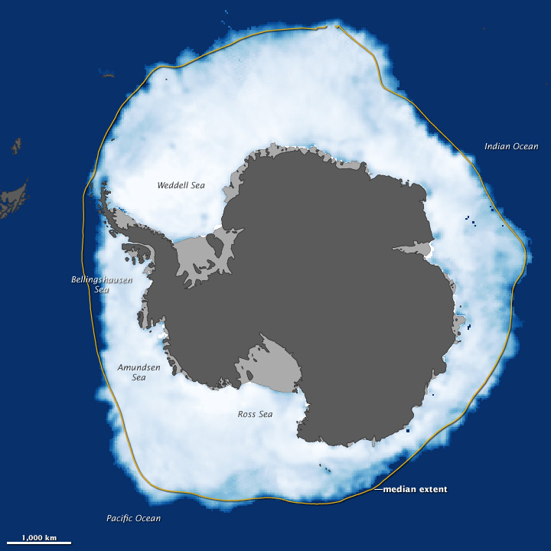
Ross Ice Sheet will Melt and Flood Florida!

Slide 34
Climate Change Discussion is Tied to Water
https://www.walden3d.com/Climate_Change/191031_Climate_Deniers.pdf

Slide 35
Water and the Gospel of Jesus Christ
Water as:
A Purifier:
John to baptize the Messiah with water, 1 Ne. 10:9–10.
Moses smote rock and water came forth, 1 Ne. 17:29 (2 Ne. 25:20).
come forth out of waters of Judah, or waters of baptism, 1 Ne. 20:1 (Isa. 48:1).
eyes of Nephi¹ water his pillow by night because of his people, 2 Ne. 33:3.
Alma¹ and Helam are buried in water in baptism, Mosiah 18:14.
those who believe shall be born of water and of the Spirit, D&C 5:16.
cleanse your feet with pure water, D&C 84:92.
men must be born again of water and the Spirit, Moses 6:59.
by water ye keep commandment, Moses 6:60.
Adam is carried down into water by the Spirit, Moses 6:64.
A Deliverer:
Nephi¹ beholds many waters separating his seed from Gentiles, 1 Ne. 13:10, 12–13, 17, 29.
people of Lehi¹ call sea Irreantum, meaning many waters, 1 Ne. 17:5.
every one that thirsteth, come to waters, 2 Ne. 9:50.
with joy shall ye draw water out of wells of salvation, 2 Ne. 22:3 (Isa. 12:3).
lands of Nephi and Zarahemla nearly surrounded by water, Alma 22:32.
A Destroyer:
by Moses’ word, waters of Red Sea were divided, 1 Ne. 17:26 (Hel. 8:11).
slain Lamanites and Amlicites are cast into waters of Sidon, Alma 3:3.
the Lord causes waters to come up in places of cities, 3 Ne. 9:7.
bitter fountain cannot bring forth good water, nor good fountain bitter water, Moro. 7:11.
many dangers upon waters, D&C 61:4–5.
no flesh to be safe upon waters, D&C 61:15.
destroyer rides upon face of waters, D&C 61:19.
the Lord’s presence is as fire that causes waters to boil, D&C 133:41.
Living Water:
with joy shall ye draw water out of the wells of salvation, Isa. 12:3 (2 Ne. 22:3).
every one that thirsteth, come ye to the waters, Isa. 55:1 (2 Ne. 9:50).
they have forsaken me the fountain of living waters, Jer. 2:13.
it shall be in that day, that living waters shall go out, Zech. 14:8.
asked of him, and he would have given thee living water, John 4:10.
any man thirst, let him come unto me, and drink, John 7:37.
lead them unto living fountains of waters, Rev. 7:17.
I will give unto him … of the water of life freely, Rev. 21:6.
fountain of living waters, or … the love of God, 1 Ne. 11:25.
partake of the waters of life freely, D&C 10:66.
same shall be in him a well of living water, D&C 63:23.
shall come forth pools of living water, D&C 133:29.
come unto the Lord and ye shall drink waters of life freely, Alma 5:34 (42:27).
partake of waters of life, D&C 10:66.
mysteries of kingdom to be well of living water, D&C 63:23.
pools of living water in barren deserts, D&C 133:29.
Ezekiel 47
2 Then brought he me out of the way of the gate northward, and led me about the way without unto the utter ªgate by the way that looketh eastward; and, behold, there ran out waters on the right side.
3 And when the man that had the ªline in his hand went forth eastward, he measured a thousand cubits, and he brought me through the waters; the waters were to the ankles.
4 Again he measured a thousand, and brought me through the waters; the waters were to the knees. Again he measured a thousand, and brought me through; the waters were to the loins.
5 Afterward he measured a thousand; and it was a river that I could not pass over: for the waters were risen, waters to swim in, a river that could not be passed over.
6 ¶ And he said unto me, Son of man, hast thou seen this? Then he brought me, and caused me to return to the brink of the river.
7 Now when I had returned, behold, at the bank of the river were very many trees on the one side and on the other.
8 Then said he unto me, These waters issue out toward the east country, and go down into the desert, and go into the ªsea: which being brought forth into the sea, the ^{b}waters shall be healed.

Slide 36
Notes

Slide 37
Science Camp Financial Planning
Rule of 72: How many years to 2x your $. @8% $72; 72/8% = 9 years to 2x your $.
10/20 Rule: - 10x your monthly income for emergencies. - 20x your annal salary to retire.
How much 5 do you need to make to beat taxes & inflation? 6.2%.
How much of a % does the bank give us: 1%.
How much without a financial advisor?
What is the compounding %? % on Top of %
Tax Bracket

Slide 38
Three Income Taxation Categories

Slide 39
Where are your assets now?

Slide 40
Monthly Retirement Income Worksheet

Slide 41
The Cost of Waiting

Slide 42
Water Bottle Rockets

Slide 43
Water Bottle Rockets continued

Slide 44
Notes

Slide 45
Notes
2023 Science Camp
What was best about 2023 Science Camp?
________________________________________
________________________________________
________________________________________
________________________________________
What would be your ideal 2024 Science Camp Theme?
________________________________________
________________________________________
________________________________________
________________________________________
Remember, Grandpa & Grandma will hopefully be serving a mission for The Church of Jesus Christ of Latter-Day Saints in 2024.

