Slide 1
Science Camp #150606.6
05-11 June 2015 @ Salt Lake, Escalante, the Condo, the Nelson Cabin, and surrounding area
Advisors
H. Roice Nelson, Jr., Andrea S. Nelson, & Paul F. Nelson
Attendees
Ethan E. Nelson, Grant M. Nelson, Colby C. Wright,
Taylor R. Wright, Ella D. Nelson, Halle N. Wright,
Bobbie Sophia Waldron, & Dallin Spencer Nelson

Slide 2
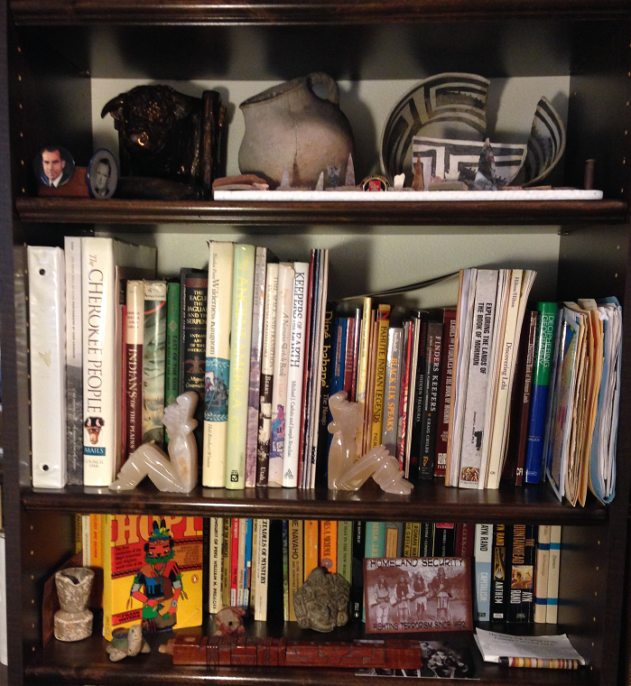
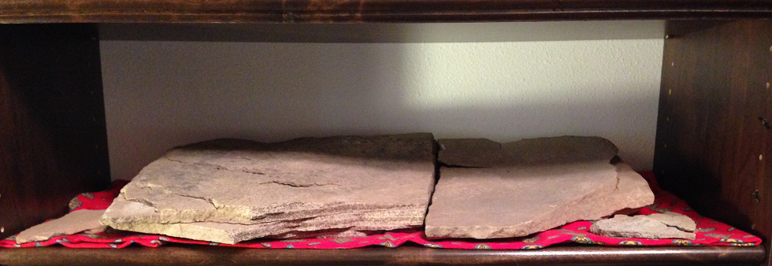
Part of Grandpa’s Indian Collection
Some of these books belonged to my Grandpa Hafen, who was one of the last of the real cowboys. He did not want to be a fruit farmer like his father Adolph Hafen, and so he went down on the Arizona Strip and caught and branded wild cattle and became nationally known in the Purebred Herford Business.

Slide 3
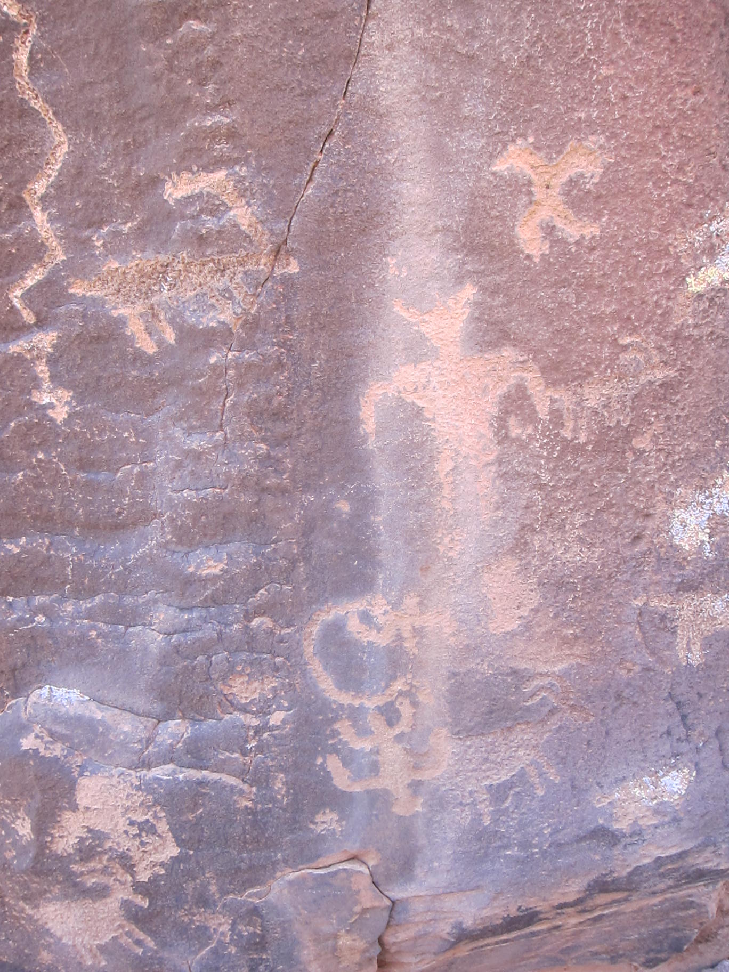
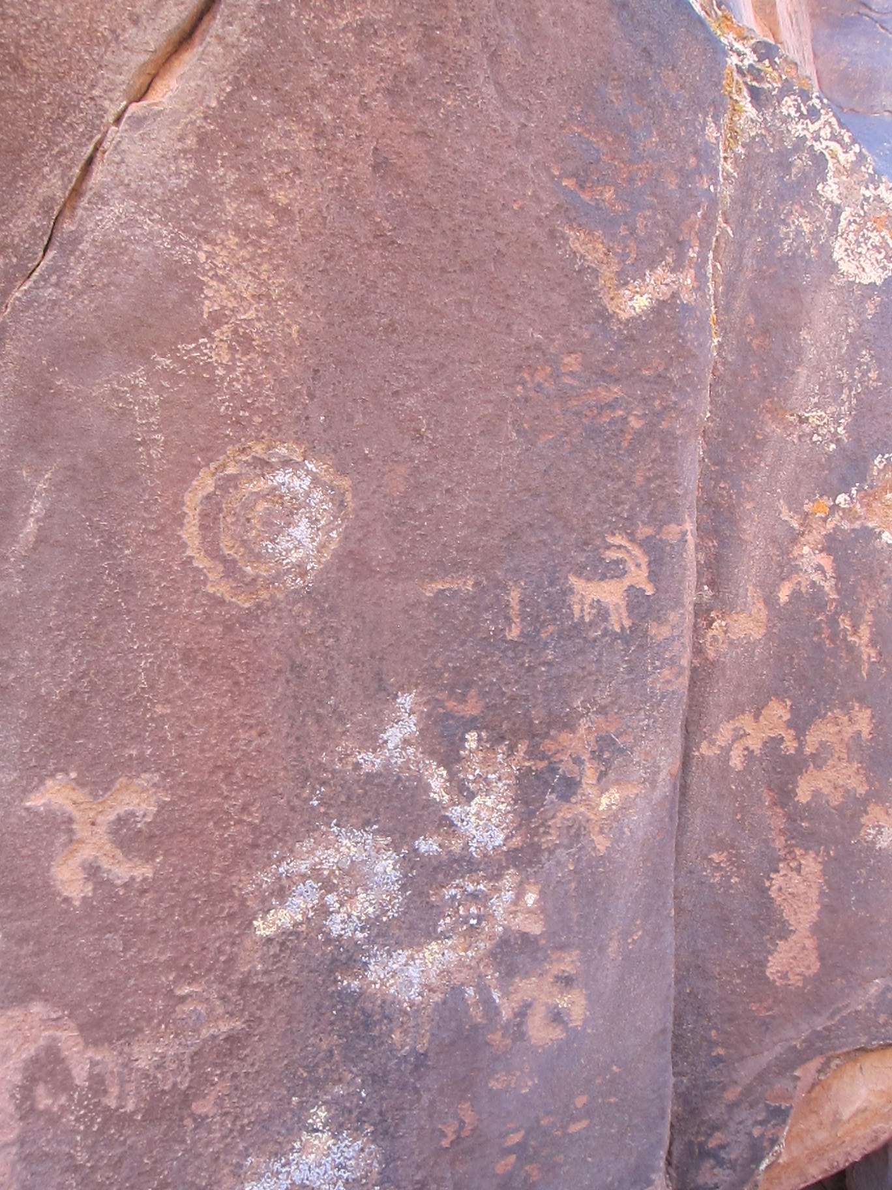
Indian Tribes & Archaeology
“Fore behold, I shall speak unto the Jews and they shall write it; and I shall also speak unto the Nephites and they shall write it; and I shall also speak unto the other tribes of the house of Israel, which I have led away, and they shall write it; and I shall also speak unto all nations of the earth and they shall write it.”
II Nephi 29:12

Slide 4
Safety
Never go anyplace alone.
Exception is if one of you is hurt, then:
One of you stay and help the person hurt.
The other one run and get help.
If you get lost stay put, we will find you.
If you hear a rattlesnake do not move quickly, just slowly move away from the sound.
Do not run with a knife open. Use knife safety.
If you cut yourself, apply pressure to the wound to stop bleeding, and send for help.
Never point an arrow in a cocked bow or a gun at any person.
Drink lots and lots and lots of water.
Do not go swimming unless an adult is with you.
Do not start branches on fire and swing them around where others can be hurt.
Have fun, use common sense, and think before you act.

Slide 5
Schedule Friday - Thursday
Friday:
Colby, Taylor, & Halle fly to Salt Lake, Paul picks up and takes to Family Discovery Center
Grandpa, Grandma, and Ethan drive to Salt Lake from Ft. Collins.
Saturday:
Sophie and Dallin’s baptism, SiliencerCo and shooting, reports.
Sunday:
Music & Spoken Word, University of Utah Science Museum, Freemont Indian Museum.
Monday:
Escalante, Anasazi Ruins, ridge road, Petrified Forest, Bryce Canyon hike, back to Condo.
Tuesday:
Parowan Gap, Solar Astronomy, Cabin, bottle rockets, marshmallow guns, Astronomy.
Wednesday:
Cabin, Swimming, Aunt Sara’s & Uncle Des’ for dinner.
Thursday:
Up early and to SLC, Wright’s plane 10:45, Ethan’s plane 2:00 PM.

Slide 6
Job Chart
 | Saturday | Sunday | Monday | Tuesday | Wednesday
Ethan | Presentation | Cleanup lunch | Lunch Setup | Dinner Setup | Clean Cabin Dinner Cleanup
Grant | Presentation | Breakfast Cleanup | Dinner Cleanup | Dinner Setup | Clean Cabin/Thur Breakfast Setup
Colby | Presentation | Setup Lunch | Breakfast Cleanup | Dinner Cleanup | Lunch Setup Clean Cabin
Taylor | Presentation | Dinner Cleanup | Breakfast Setup | Lunch Cleanup | Breakfast Cleanup Clean Cabin
Ella | Presentation | Dinner Setup | Breakfast Cleanup | Dinner Cleanup | Clean Cabin/Thur Breakfast Dishes
Halle | Presentation | Lunch Cleanup | Lunch Cleanup | Breakfast Setup | Lunch Cleanup Clean Cabin
Sophie | Baptism / Presentation | Setup Breakfast | Dinner Setup | Lunch Setup | Clean Cabin Dinner Cleanup
Dallin | Baptism / Presentation | Breakfast Cleanup | Lunch Setup | Breakfast Cleanup | Breakfast Setup Clean Cabin

Slide 7
Notes

Slide 8
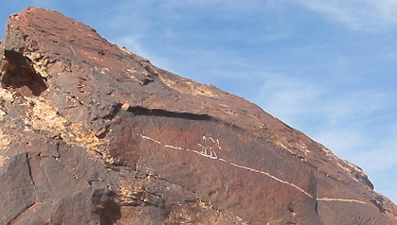
Why is Archaeology important?
Archaeology is the study of human activity in the past, primarily through the recovery and analysis of the material culture and environmental data that has been left behind by past human populations which includes artifacts, architecture, biofacts (also known as eco-facts) and cultural landscapes (the archaeological record).
[http://en.wikipedia.org/wiki/Archaeology]
To know where we are and where we are going, we must first know where we came from.
The purpose of archaeology is to learn about the human race and past societies: what worked and what did not work.
This allows us to make better decisions for us and our lives, for our families, and for our society.

Slide 9
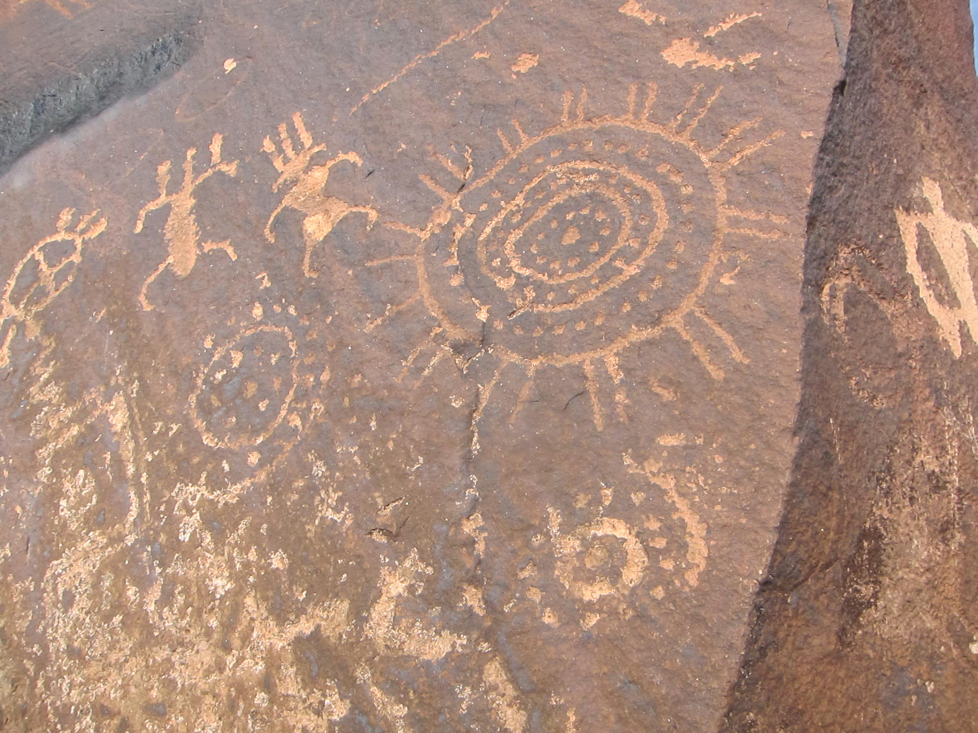
An Old Kind of Science

Slide 10
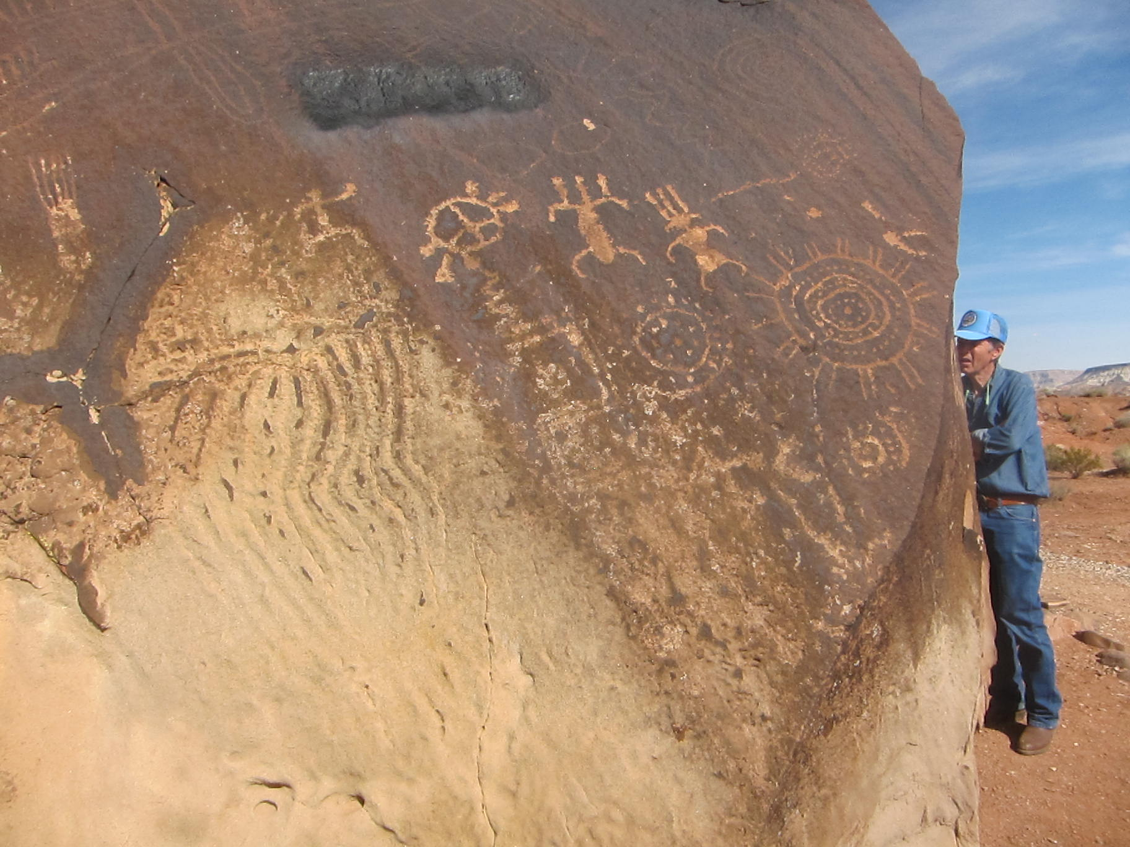
What do you think of those who deface our common history?

Slide 11
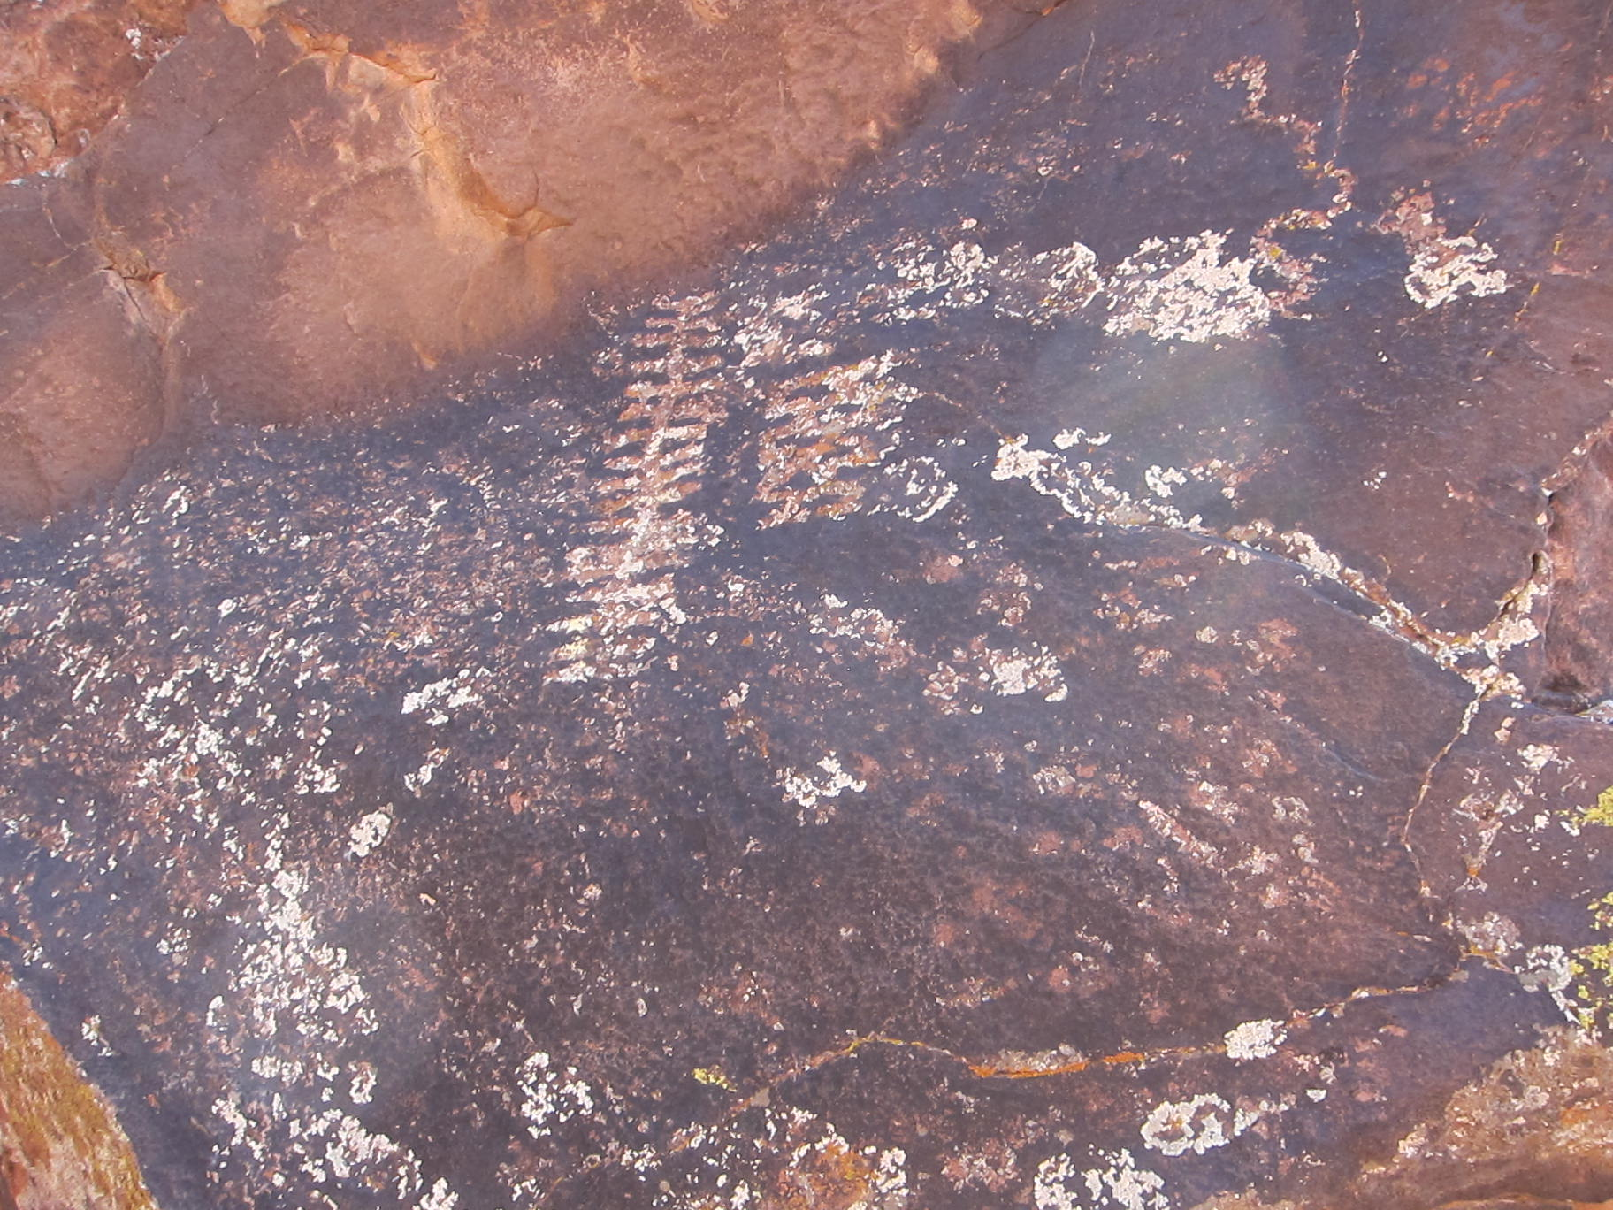
There are mysteries to be resolved!

Slide 12
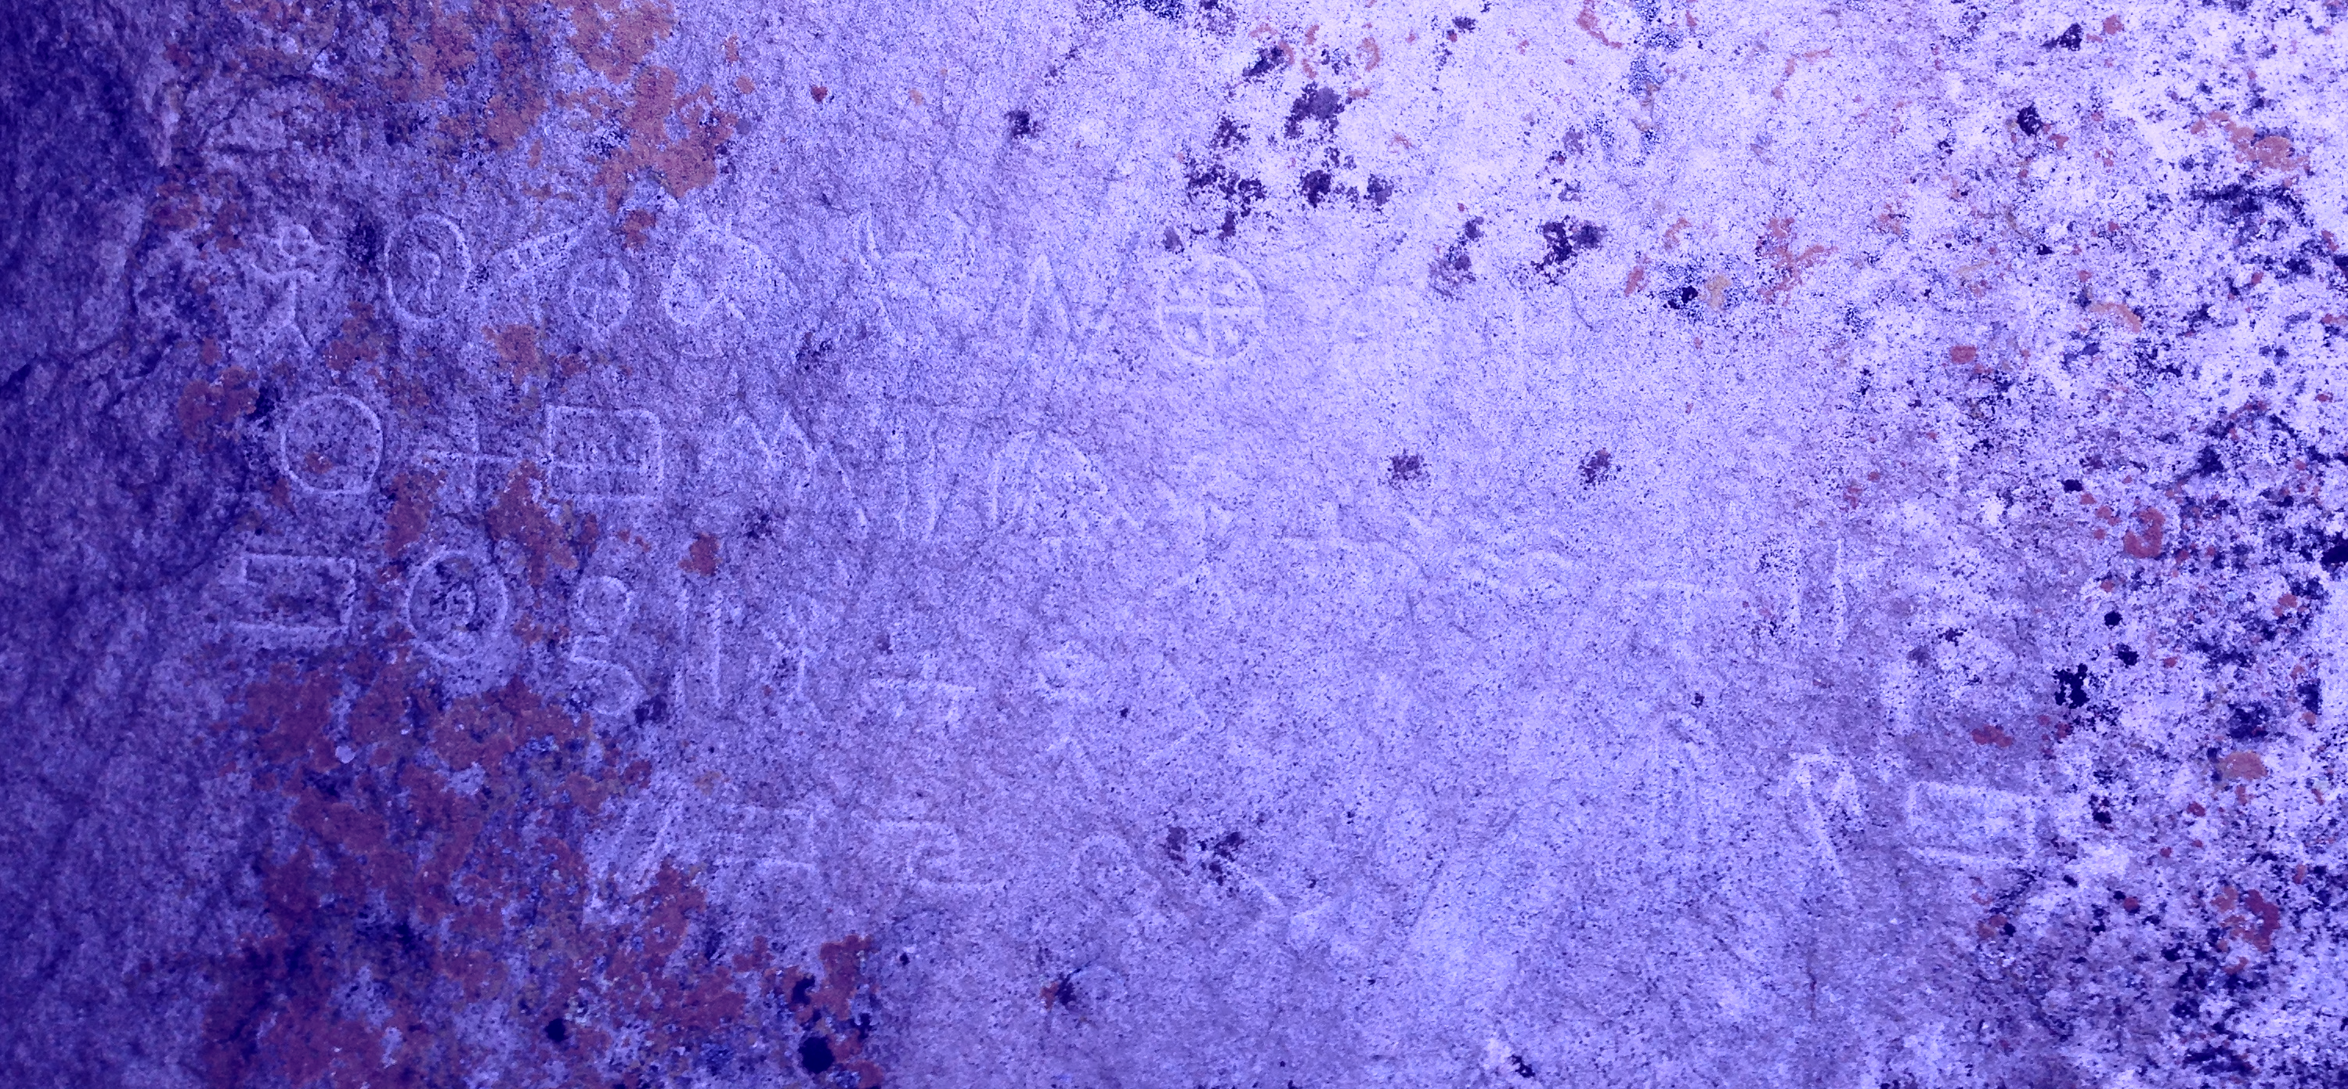
Who carved these patterns near Cedar? The place is known as Moroni’s Cave.

Slide 13
Notes

Slide 14
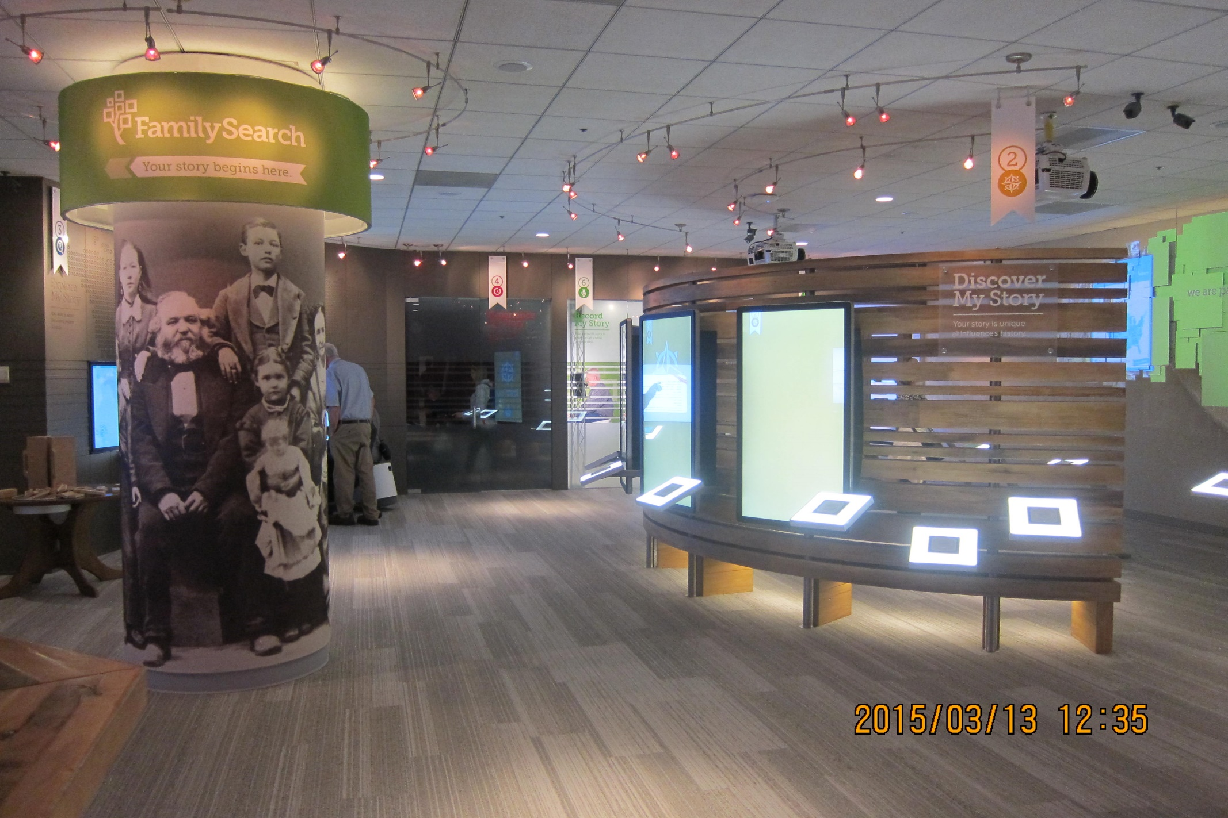
Family Discovery Center

Slide 15
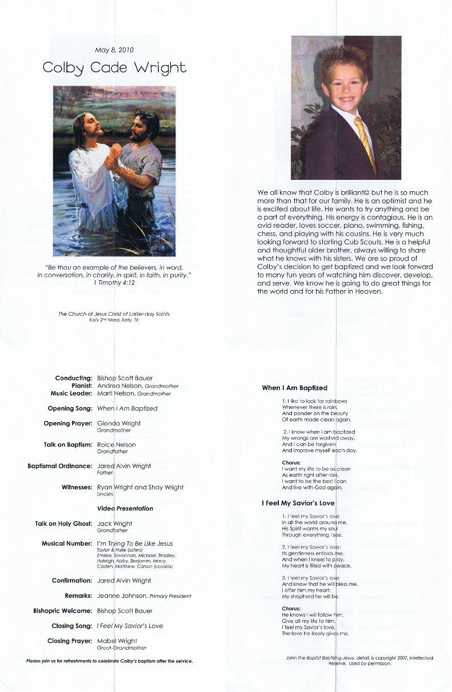
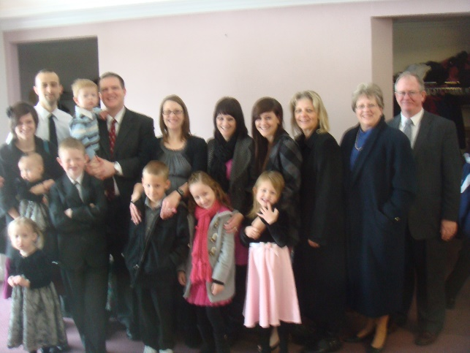
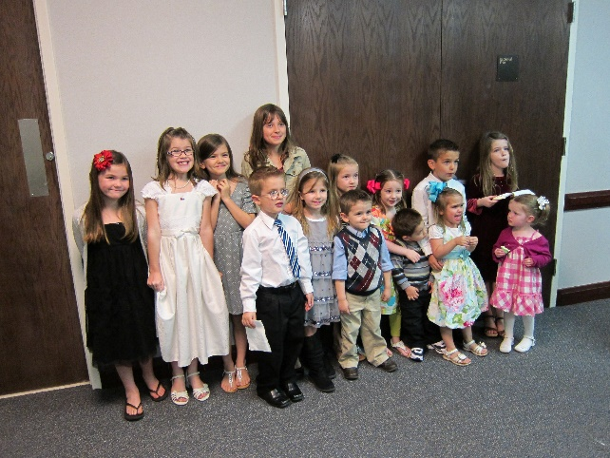
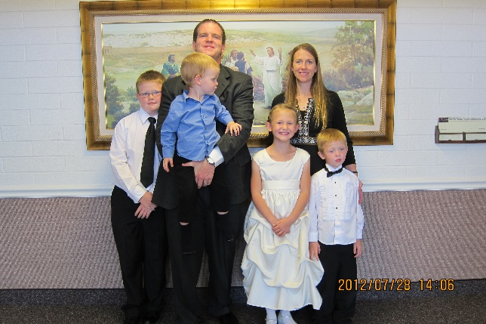
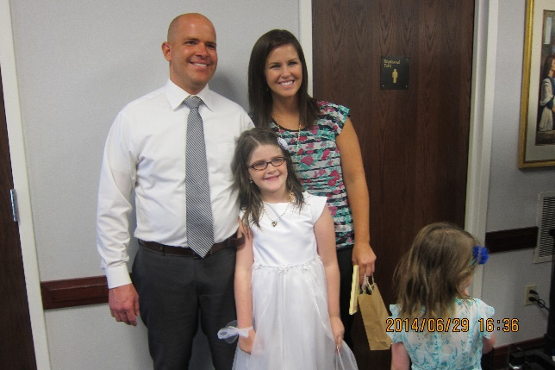
Sophie’s and Dallin’s Baptism
Grant Matthew Nelson Taylor Robbyn Wright
Ella Dawn Nelson Halle Nalise Wright

Slide 16
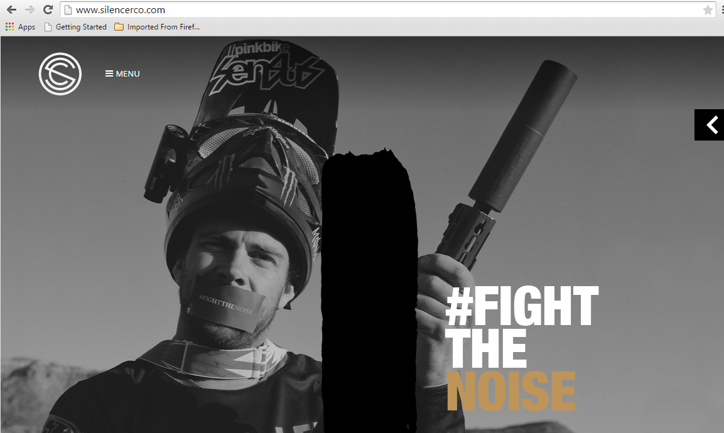
SilencerCo
Never, never, never point a gun or a bow at another person.

Slide 17
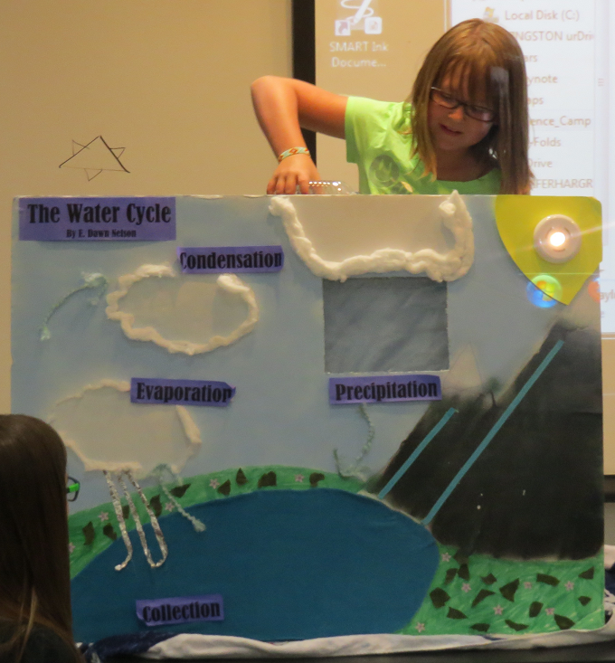
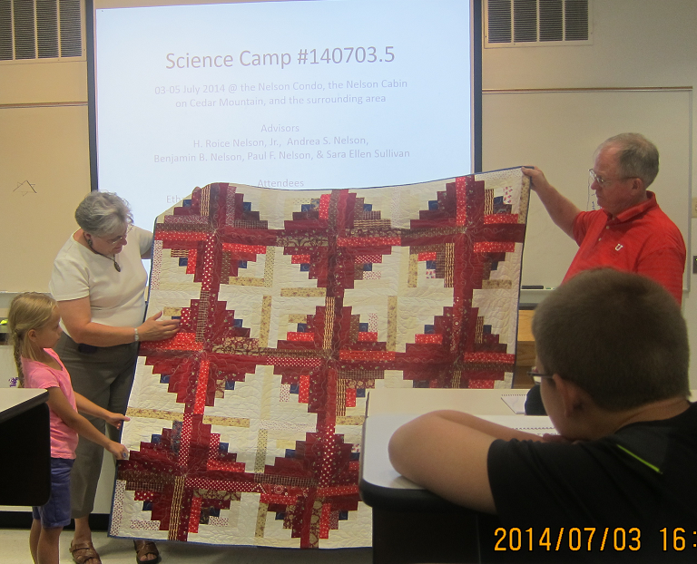
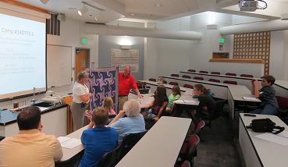
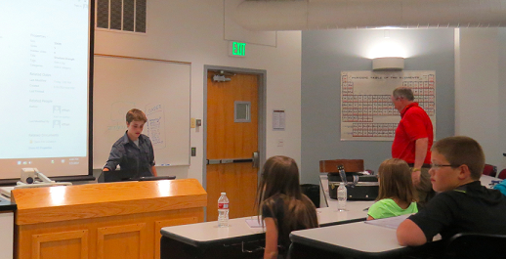
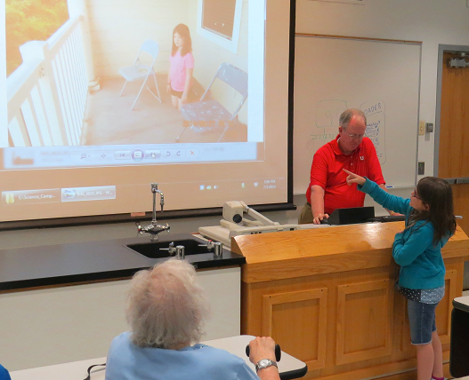
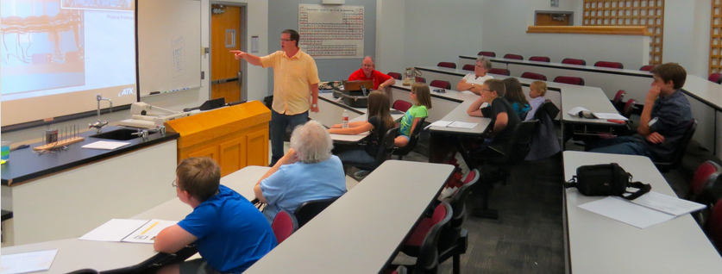
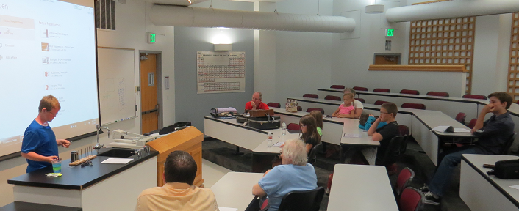
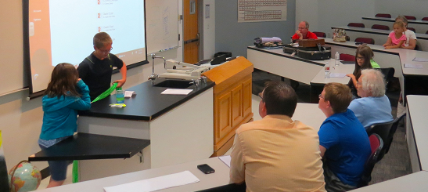
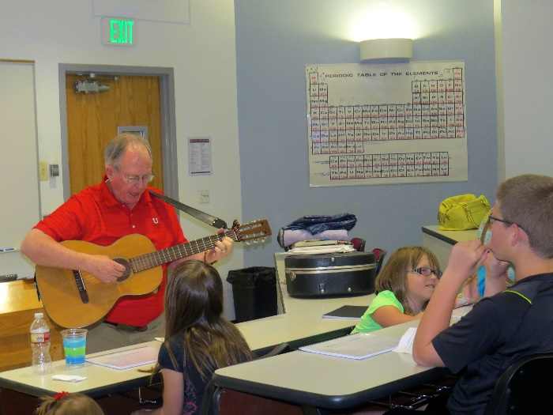
Reports

Slide 18
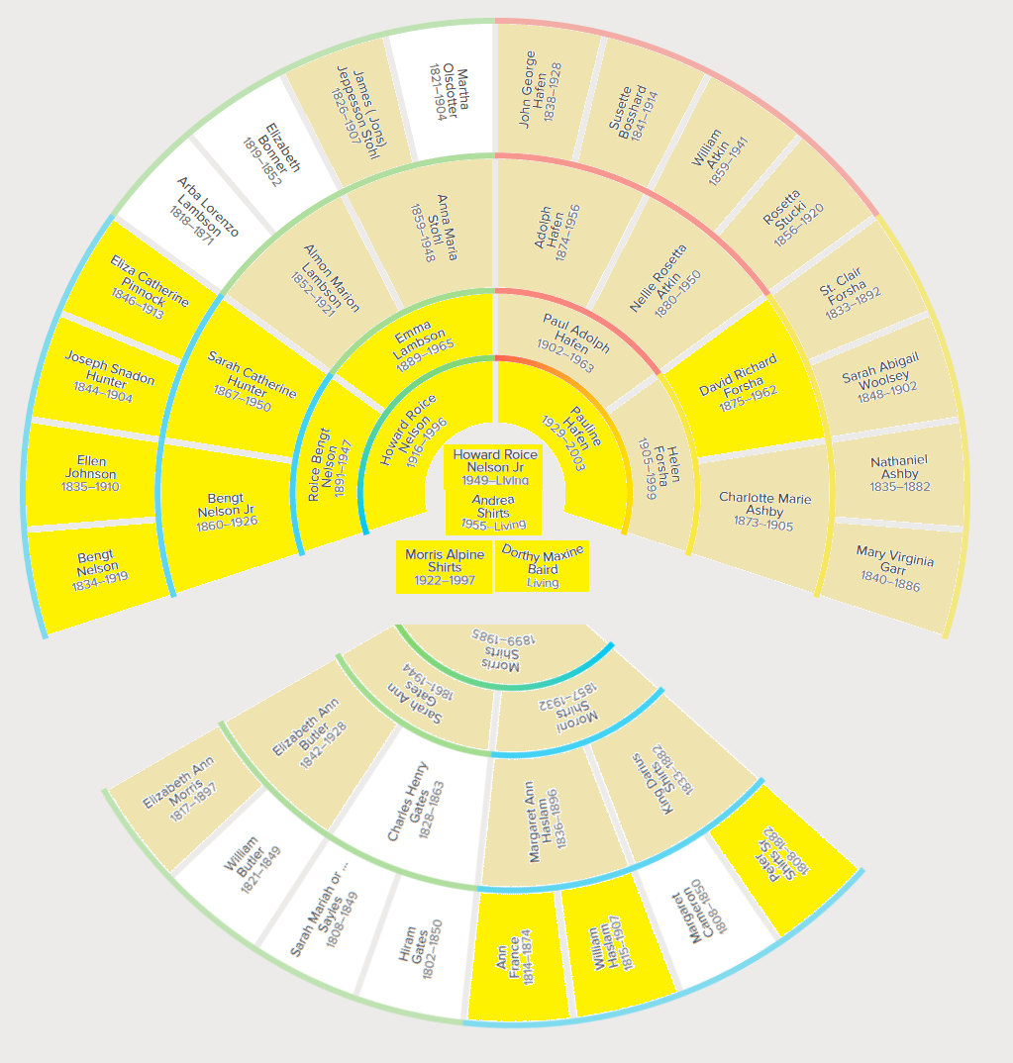
Ancestor Stories & Histories

Slide 19
Notes

Slide 20
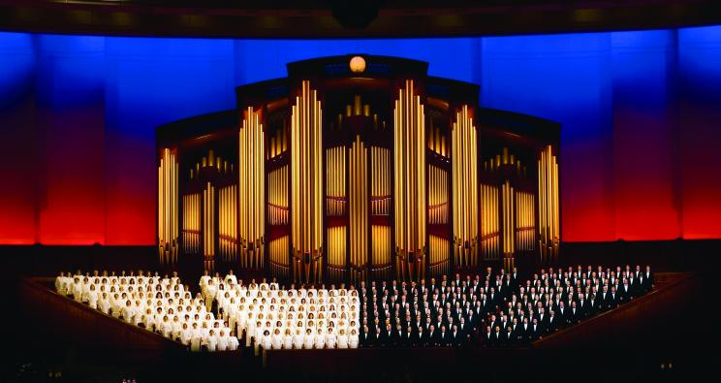
Music and The Spoken Word

Slide 21
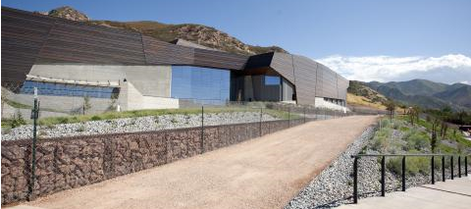
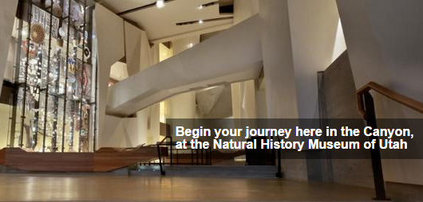
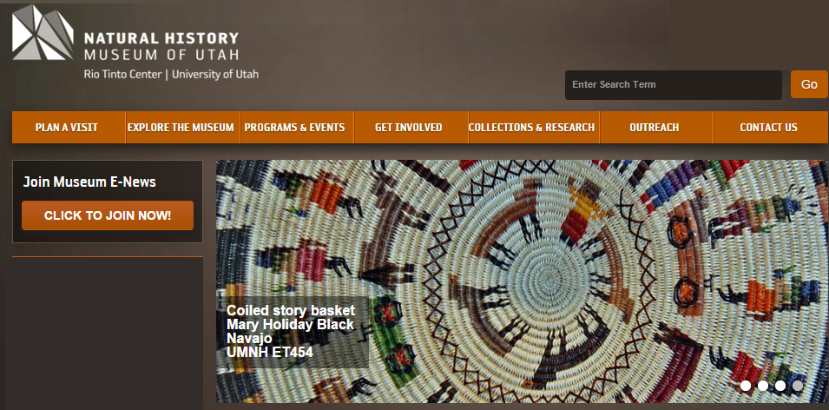
University of Utah Museum

Slide 22
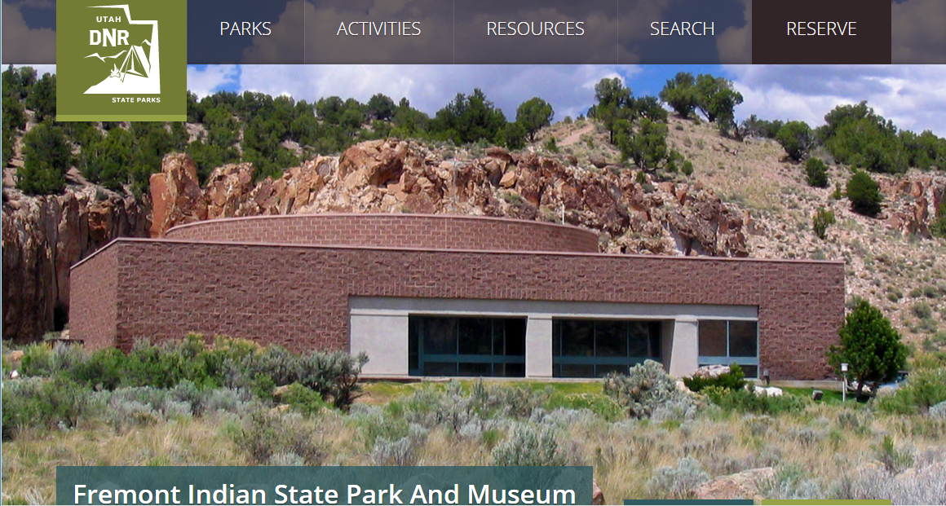
Freemont Indian Museum

Slide 23
Status Report on Grandpa’s work with Lightning Data

Slide 24
Notes

Slide 25
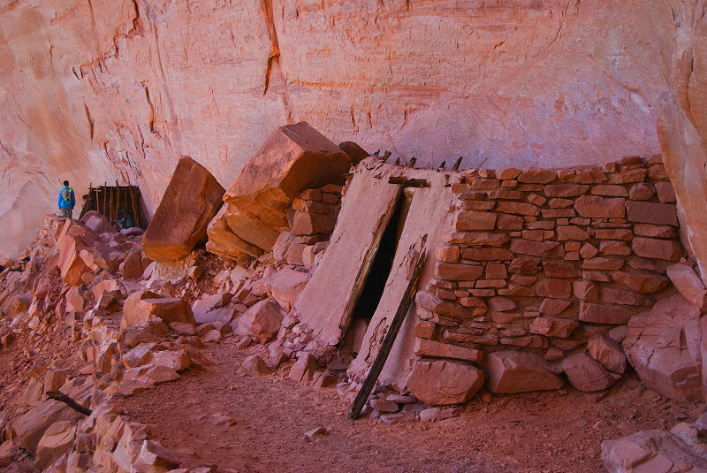
Anasazi Ruins Escalante

Slide 26
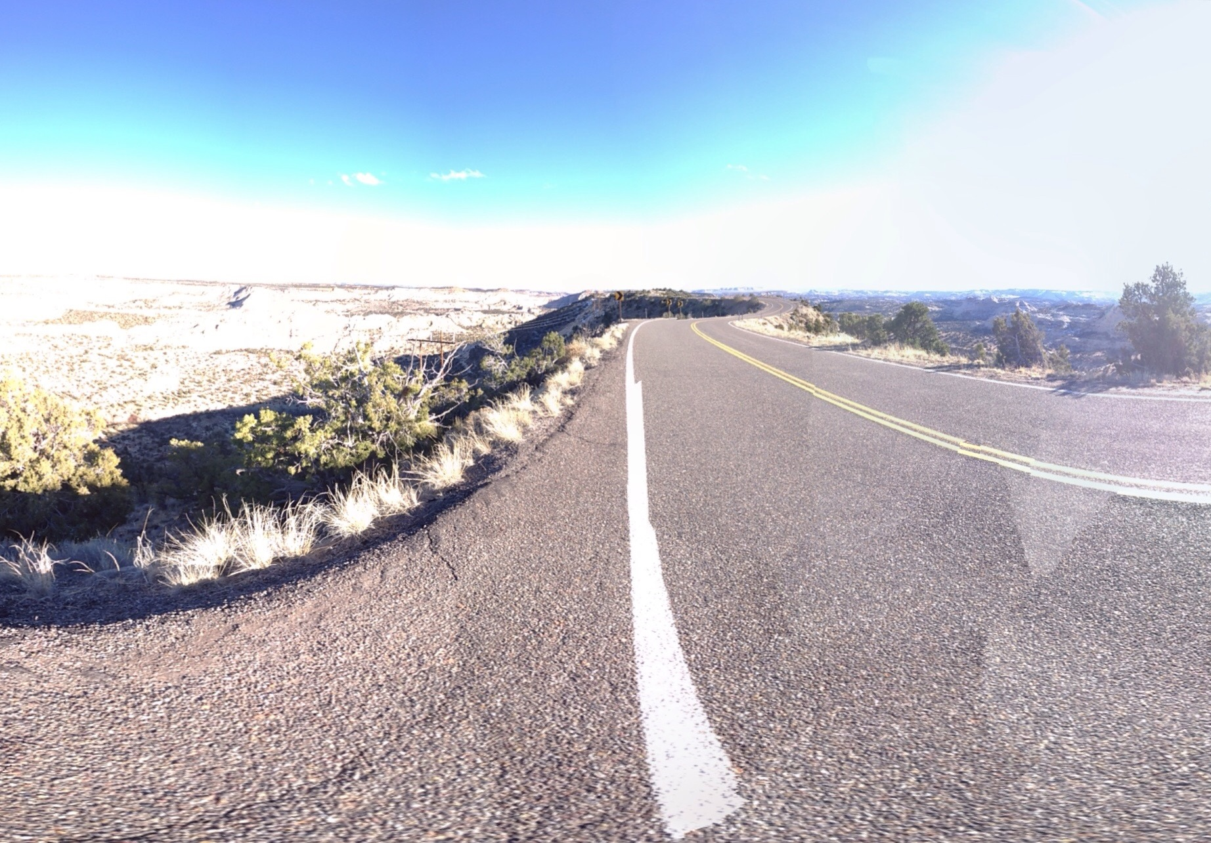
Ridge Road

Slide 27
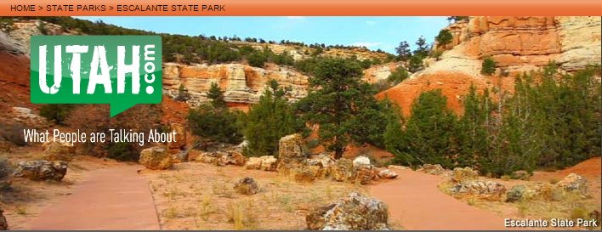
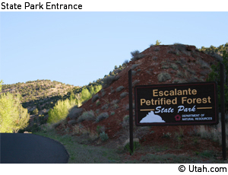
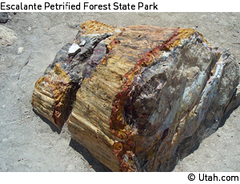
Petrified Forrest

Slide 28
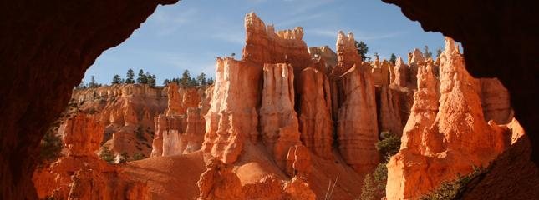
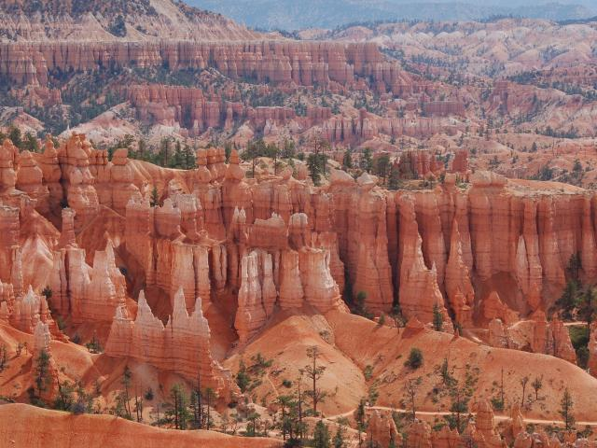
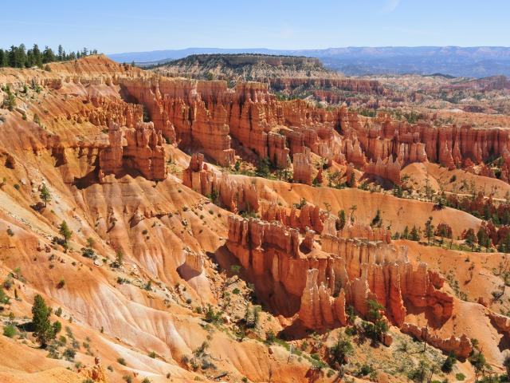
Bryce Canyon

Slide 29
Notes

Slide 30
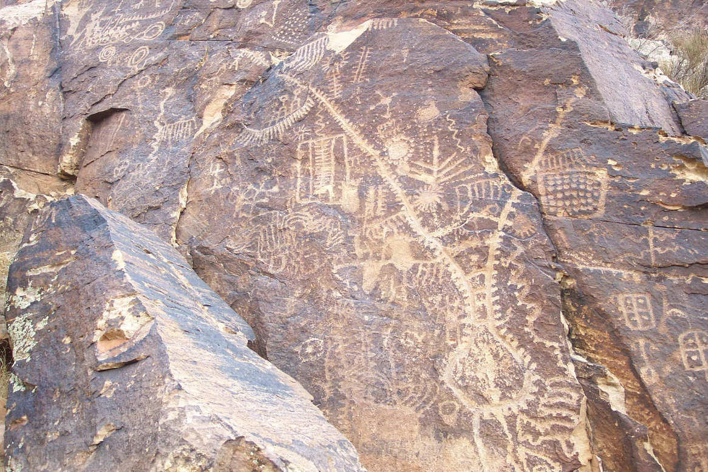
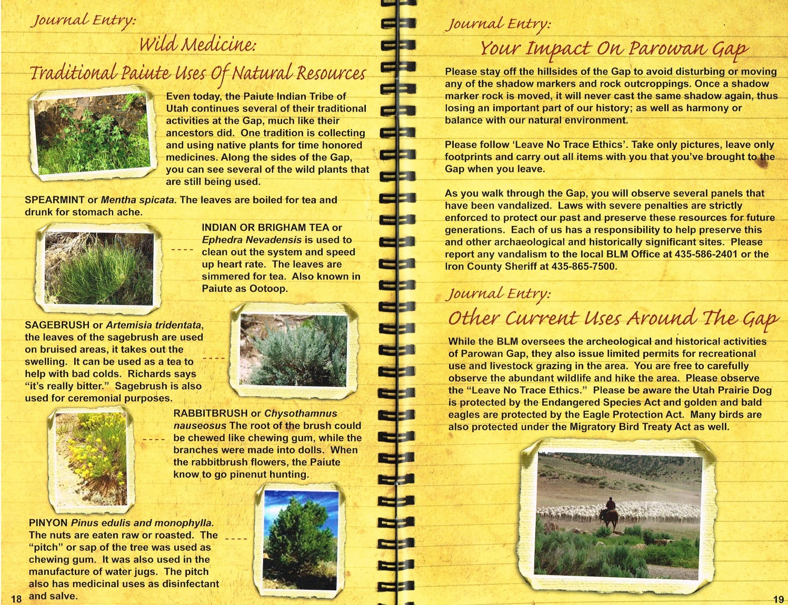
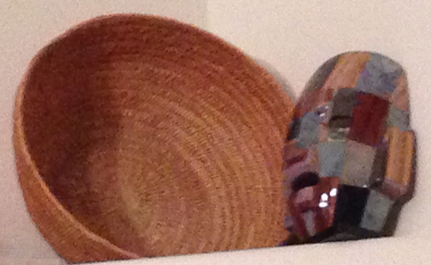
Parowan Gap
Emma Lambson Nelson’s Piute basket

Slide 31
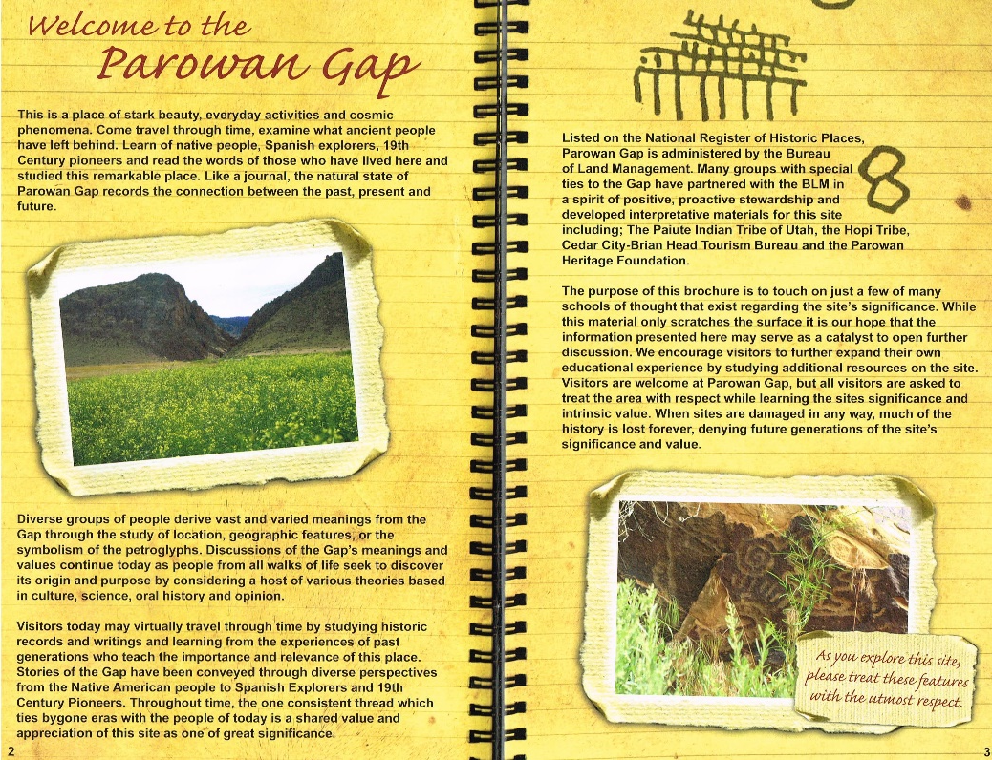
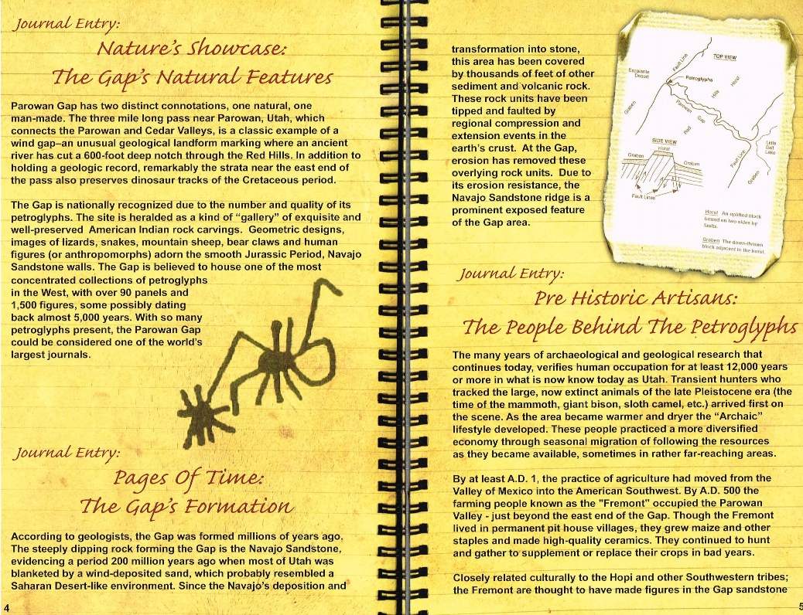
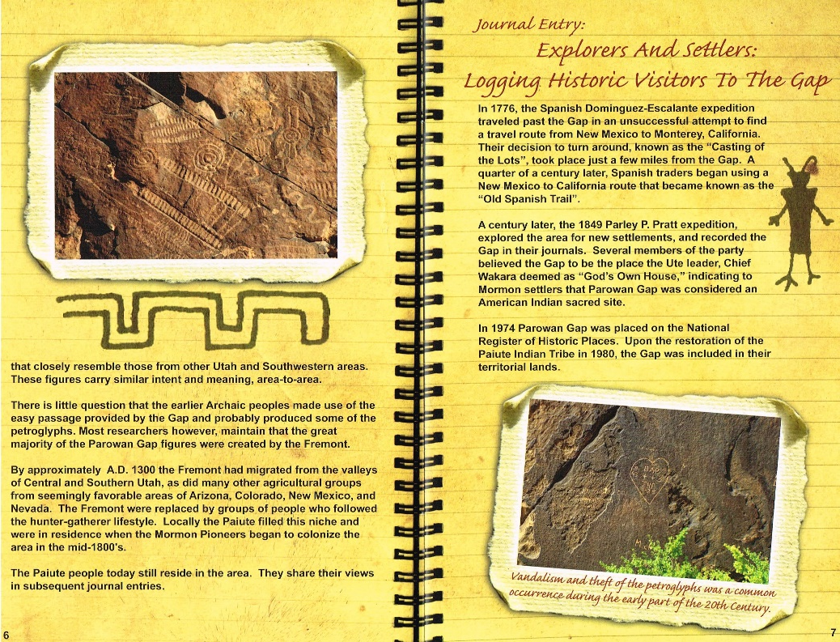
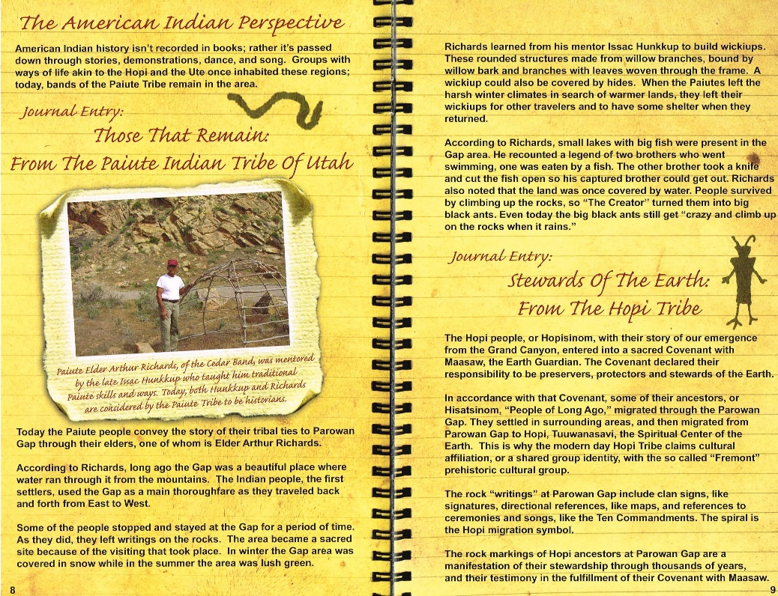
Gap Details

Slide 32
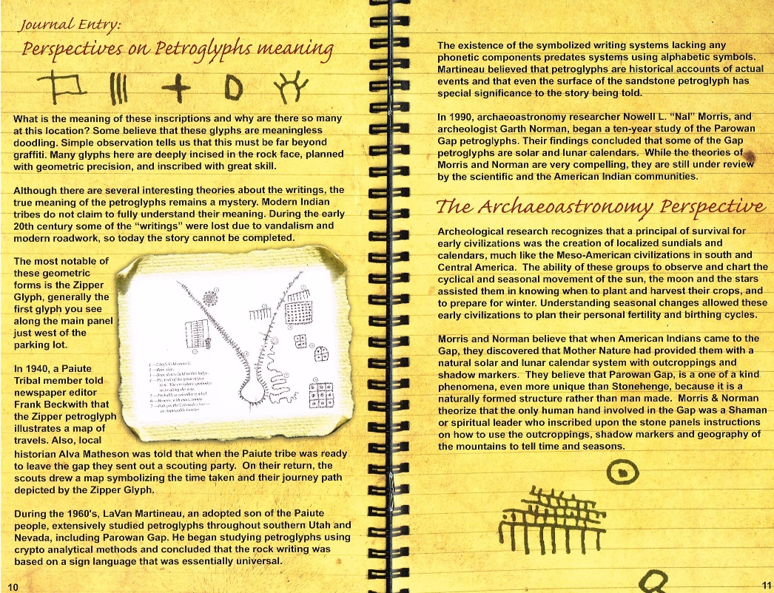
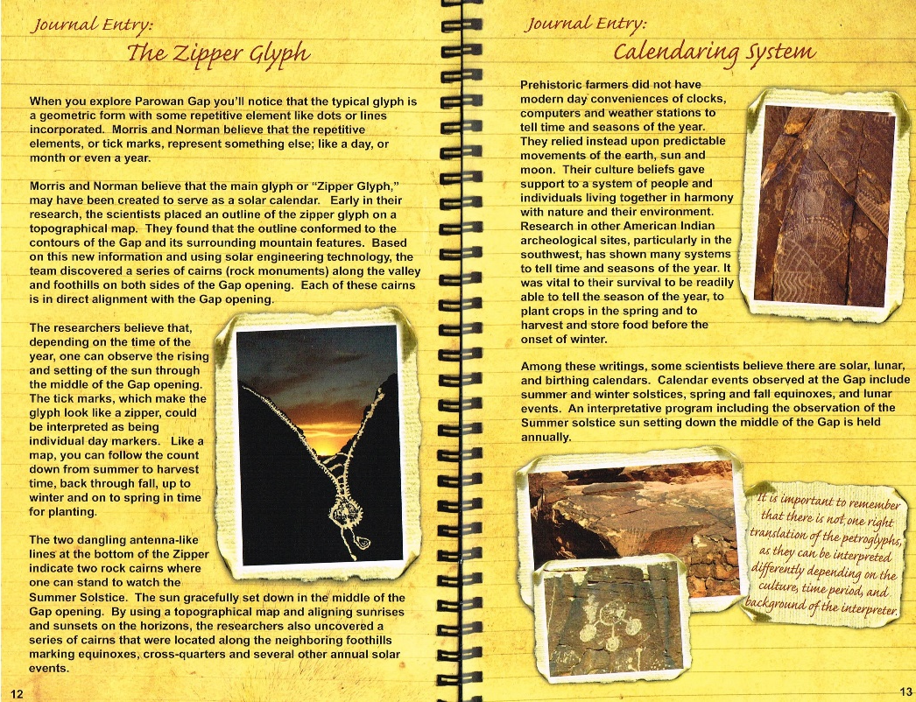
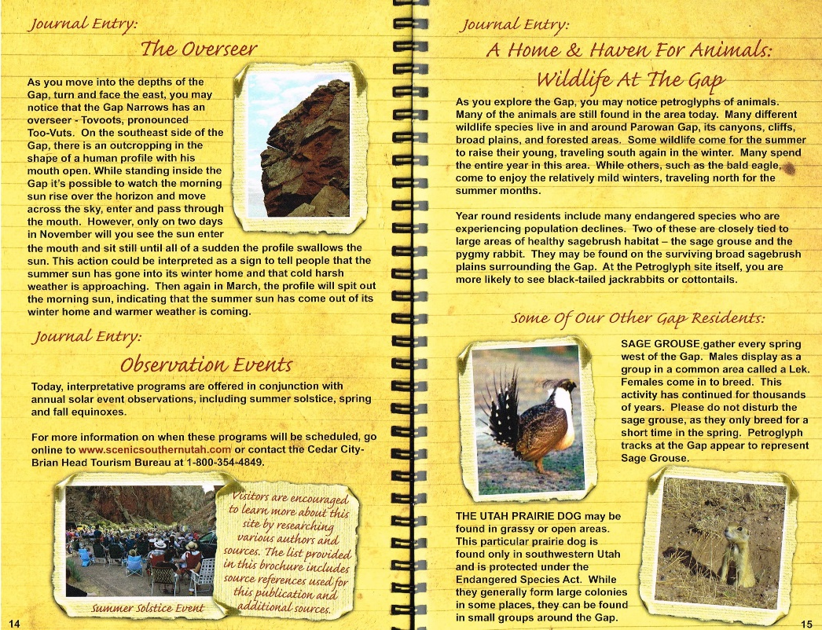
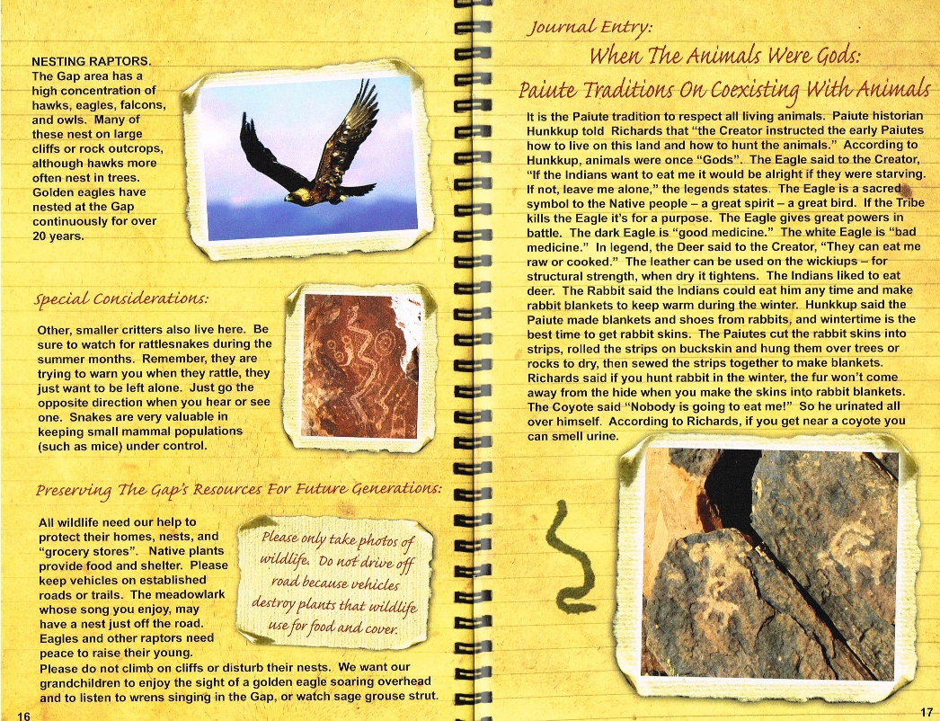
Gap Details

Slide 33
Nelson Cabin

Slide 34
Solar & Lunar Astronomy with Hilton Long

Slide 35
Night Astronomy with Hilton Long, Ray Gardner, & Brent Sorenson

Slide 36
Notes

Slide 37
Water Bottle Rockets

Slide 38
Water Bottle Rockets continued

Slide 39
Nelson Cabin Map

Slide 40
Reference Grid
26 36 46 56 66 76
25 35 45 55 65 75
24 34 44 54 64 74
23 33 43 53 63 73
22 32 42 52 62 72
11 21 31 41 51 61 71

Slide 41
More Detail Reference Grid
66.41 76.11 76.21 76.31 76.41
16.14
16.13
16.12
16.11
15.14
11.11 11.21 11.31 11.41 21.11

Slide 42
Find Quarter Section Corners at Cabin

Slide 43
Swimming om Cedar City

Slide 44
Dinner with Uncle Des & Aunt Sara

Slide 45
Notes

Slide 46
2015 Science Camp
What was best about 2015 Science Camp?
__________________________________
__________________________________
__________________________________
What would be your ideal 2016 Science Camp?
__________________________________
__________________________________
__________________________________

