Slide 1
Merry Christmas
and a
Happy New Year
to you and yours!
(more at http://www.walden3d.com/photos/Christmas/Christmas_Cards/2014_Christmas_Card )
H. Roice Nelson, Jr. &
Andrea Shirts Nelson
2155 West 700 South #31
Cedar City, UT 84720
Dear Friends and Family,
Merry Christmas from Cedar City. The background photo shows our house at night and our first lights on the tree in the back yard. Our kids and grandkids are our presents. The photos start upper left and go to the right, then downward. We enjoyed our “penthouse” for a year, along with Andrea’s Valentine ball. We said goodbye to the deer and the pigs, with Roice’s farewell concert at Ken Turner’s studio. Roice sings in the Master singers, and we both sang in The Messiah. Ben, Ashley (not pictured), and Matt joined Sara, Tim, and Roice in Austin for a family lunch. Heather came and raced in Cedar City. We enjoy being close to Mom Shirts. We made it to two of Ethan’s hockey games in the Denver area. Chloe Grace joined Paul, Kate, Grant, Ella, Dallin, Quinton, and their Christmas decorated house. Rob had dinner with Dad and Melanie’s family in Houston. We miss getting together with Jared, Melanie, Colby, Taylor, Halle, Avalyn, and Kendall Wright weekly, but enjoyed Halle’s baptism and Great-Grandma Mabel. We were able to go to temple square with Rachel, Garrett, and Gwen Olson and Joshua, Audrey, Sophie, Isabella, and Lauren Waldron to see the Christmas lights.
We look forward to when you visit us in Cedar. We hope & pray you and yours are happy and full of joy this Christmas Season.
With Love,

Slide 2
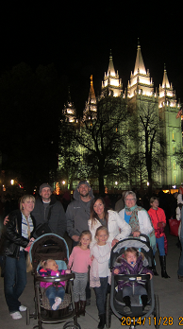
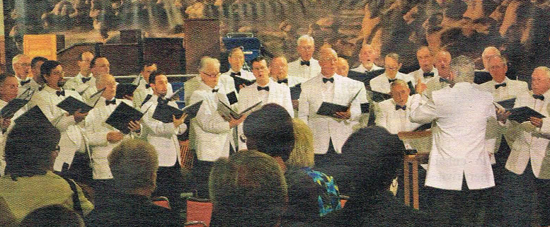
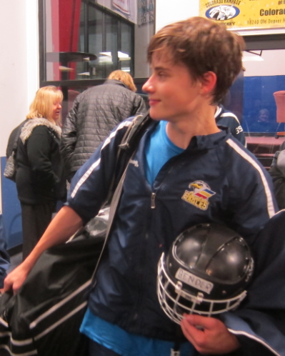
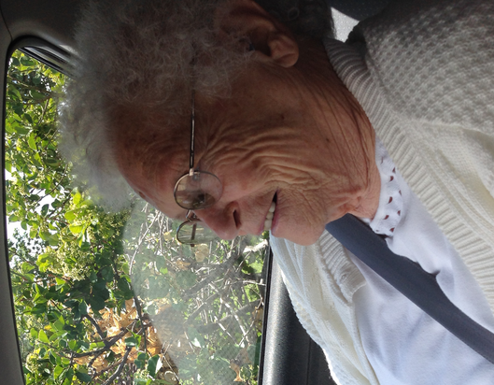
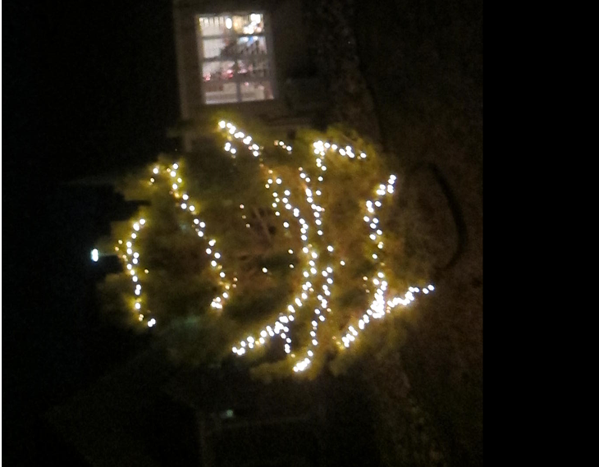
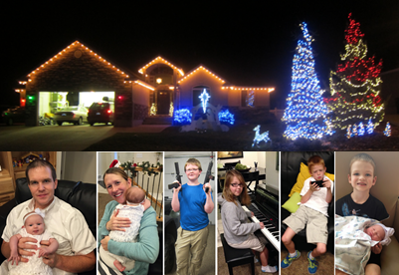
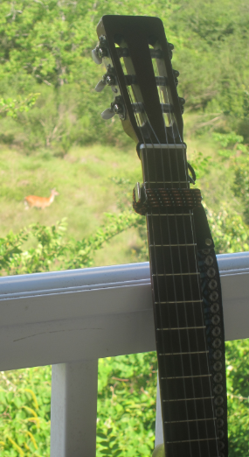
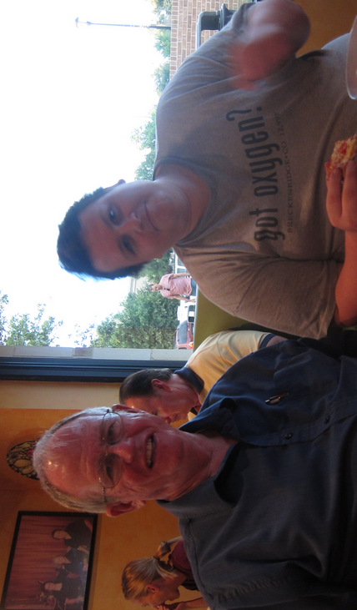
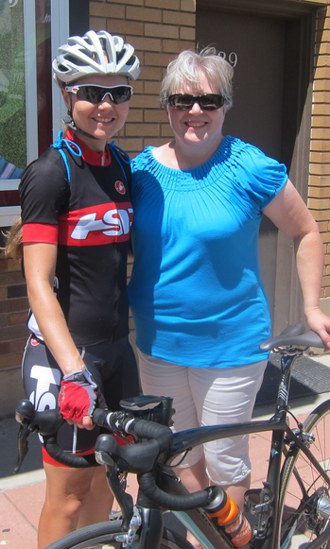
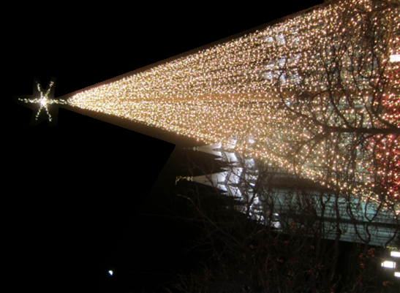
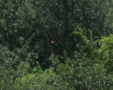
Christmas 2014 Cedar City, Utah

