Slide 1
Merry Christmas
and a
Happy New Year
to you and yours!
(more at http://www.walden3d.com/photos/Christmas/Christmas_Cards/2012_Christmas_Card )
Dear Friends and Family,
Hello to all from Houston. We were able to spend a lot of time with Melanie and her family (1), attend Taylor’s baptism (2), and Kendall’s blessing (3). March brought fire trucks to the front yard (neighbor’s home) (4). Andrea was able to visit Audrey and Rachel and families in April (5), while I picked blackberries (6). Taylor and Colby rode to science camp with us and we visited Carlsbad (7) and 4-Corners (8). Science camp started at Grandma Shirts for breakfast (9), then Geocaching (10 & 11), Ben in the gap (12), and looking at Cedar City from the “C” (13). Taylor caught a big fish (14), and we went to West Zion (15). The boys went to Cascade Falls (16) while the girls did pottery with Aunt Marilyn (17). The boys also explored Mammoth Cave (18) before singing songs (19). Andrea made dresses for the girls (20) and Grandma Shirts told us about Grandpa Shirts (21). The kids were introduced to their Nelson Grandparent’s resting places back to a 6th Great Grandmother (22). Andrea and I went to Peter Shirts’ wedding (23), saw Sophia and Isabella (24), played Jinga with Aunt Sara and Uncle Des (25), went to the Nelson Reunion (26), and Ella Dawn’s baptism (27). Back in Houston for Matt’s birthday (28), to Austin for Sara and Roice’s birthdays (29), and saw Jared as Bumblebee at the trunk-or-treat (30). Rob and Jules (31) joined us for birthday cake (32). Joshua / Silencerco awarded one of the top new Utah businesses (33). Heather continues to ride (34) and Rachel and Garrett are great hosts in their new home (35). We hope & pray you are happy this Christmas Season.
With Love,
H. Roice Nelson, Jr. &
Andrea Shirts Nelson
1307 Emerald Green
Houston, TX 77094

Slide 2
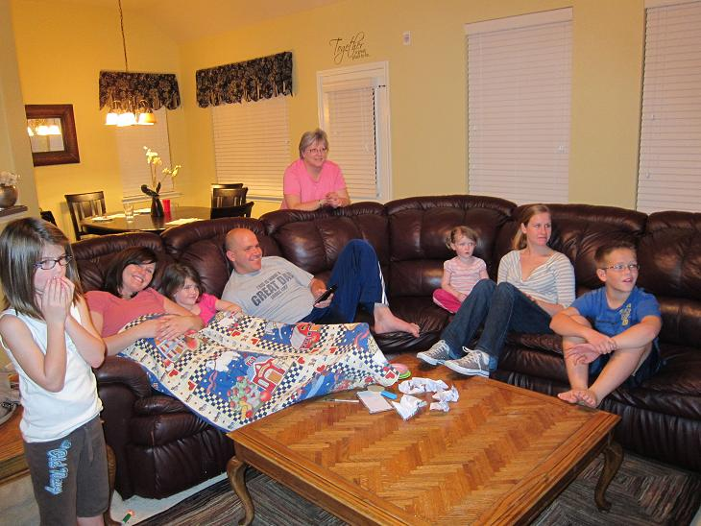
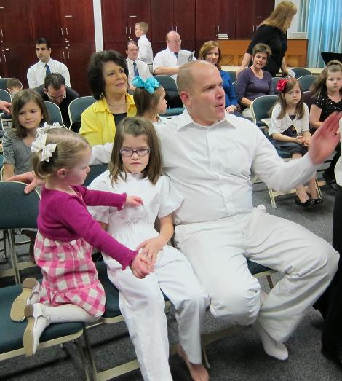
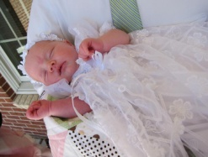
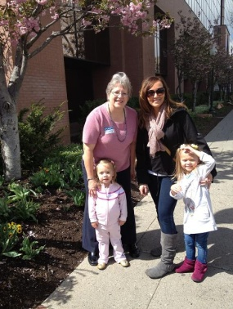
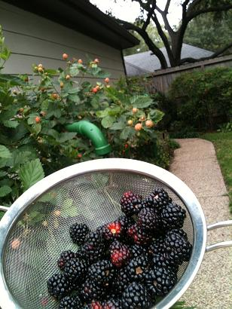
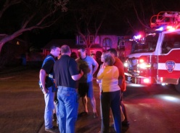
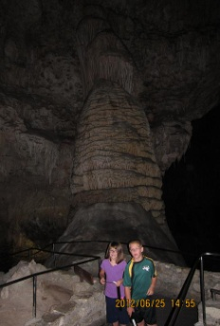
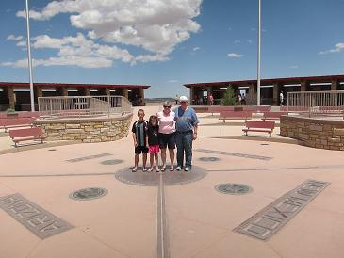
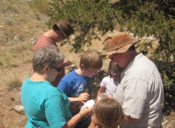
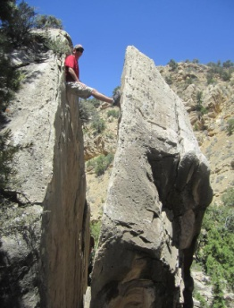
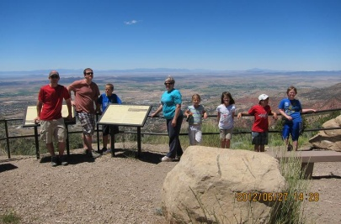
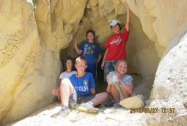
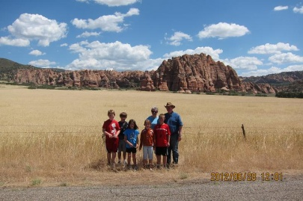
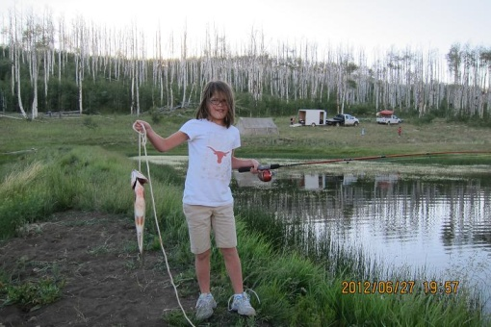
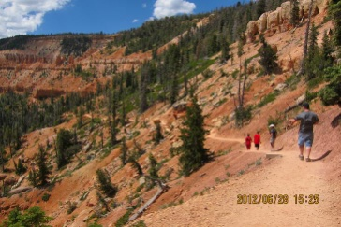
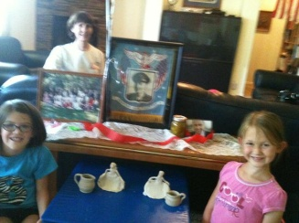
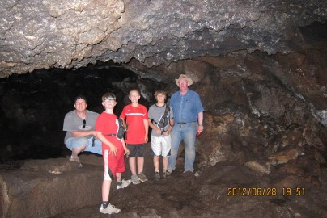
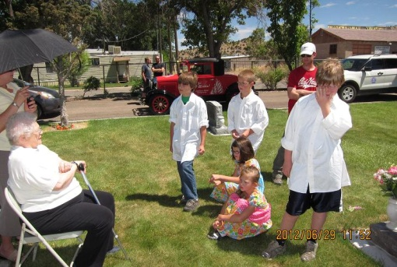
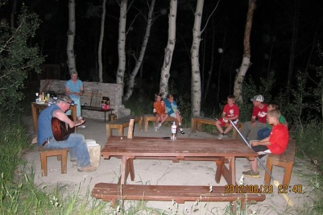
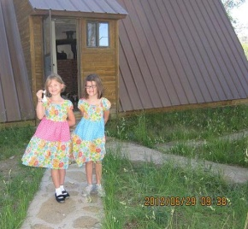
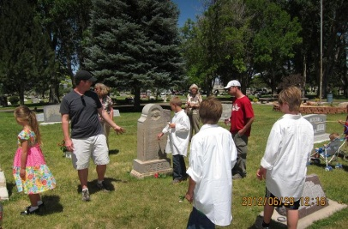
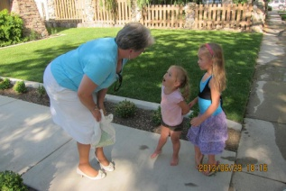
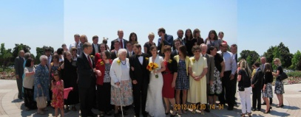
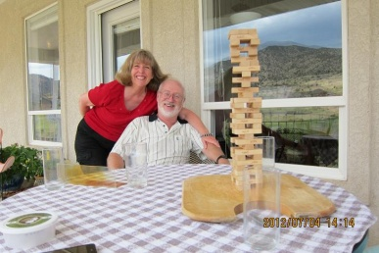
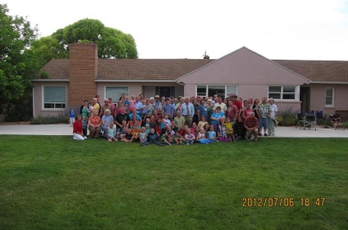
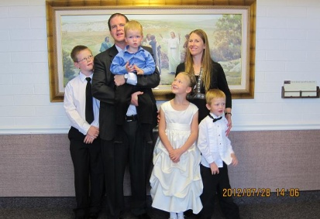
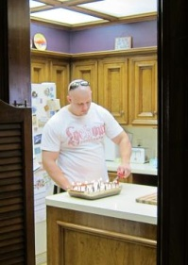
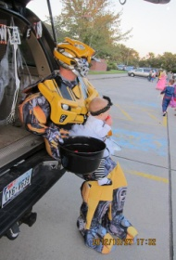
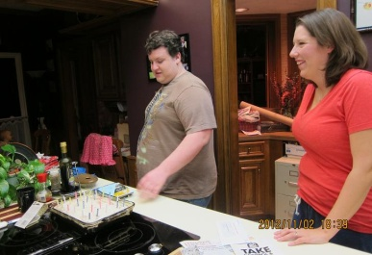
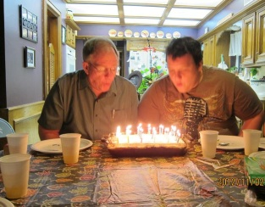
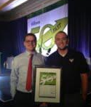
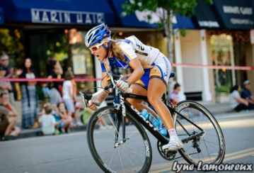
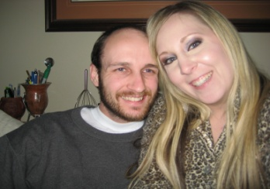
1
3
6
2
4
5
8
10
12
13
11
7
9
15
17
14
16
21
18
22
19
20
23
29
24
27
30
25
26
28
31
33
34
32
35

